Slide 1
Aggressive surgery for pancreatic neuroendocrine tumors (pNETs)
N. Bacalbasa, S. Dima, I. Popescu

Slide 2
Generalities
Are rare malignancies, with reported incidence of 0.32 per 100,000 persons/ year;
However, increasing incidence has been reported in the last decades
Peak incidence occurs between the ages of 70 and 90 years
Represent 1- 2% of all pancreatic neoplasm ^{(1, 2)}
Carry a better prognosis than exocrine pancreatic tumors, but are often metastatic at diagnosis.
Nodal or liver metastases are found at presentation in 40- 70% of PNETs patients.
1. Oberg K, Eriksson B. Endocrine tumours of the pancreas. Best Pract Res Clin Gastroenterol. 2005;19:753–81.
2. Halfdanarson TR, Rubin J, Farnell MB, Grant CS, Petersen GM. Pancreatic endocrine neoplasms: epidemiology and prognosis of pancreatic endocrine tumors. Endocr Relat Cancer. 2008;15:409–27.

Slide 3
Classification
pNETs
Functional
Produce hormones such as insulin, glucagon, gastrin, vasoactive intestinal peptide, somatostatin
The two most common types include insulinomas and gastrinomas
Non-functional
Are detected incidentally during abdominal imaging performed for other reasons
More common in patients with MEN1 syndrome
May actually produce multiple hormones and peptides such as neurotensin, pancreatic polypeptide, chromogranine A and neuron-specific enolase

Slide 4
Classification

Slide 5
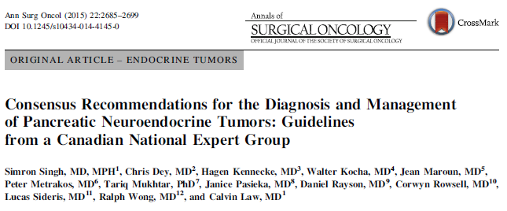
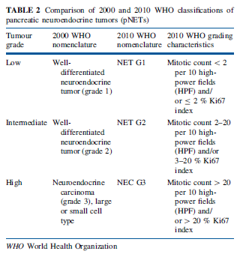
Classification
The initial WHO classification of pNETs promoted in 2000 was modified 10 years later according to ENETS classification (that places considerable emphasis on proliferation and is stage independent)

Slide 6
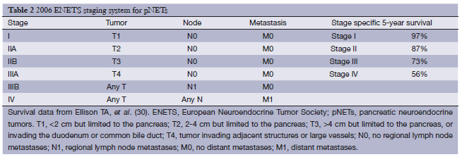
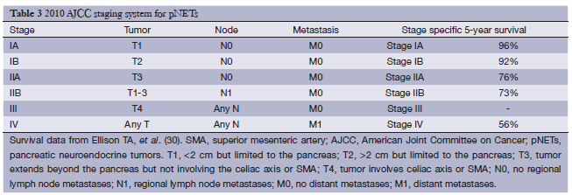
Classification

Slide 7
General principles for surgical management of pNETs
pNETs should ideally be managed in a multidisciplinary setting
Surgery with curative intent should be considered in all cases if clinically appropriate and technically feasible
Enucleation – acceptable surgical approach for small, well differentiated pNETs (<2 cm, G1 tumors)
Radical resection (based on the same oncologic principles as those applied to pancreatic adenocarcinomas) is indicated for larger, moderately or poorly differentiated tumors

Slide 8
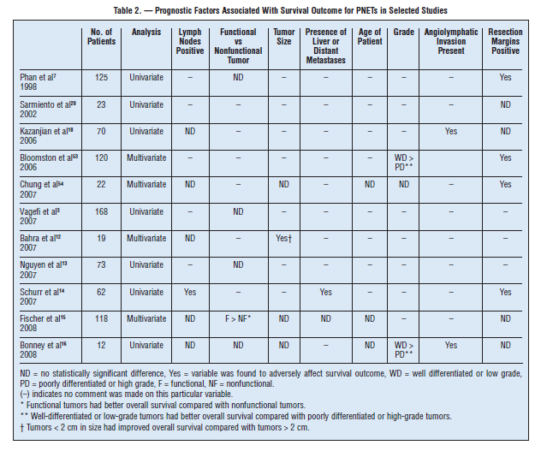
Prognostic factors influencing surgical decision making

Slide 9
Locally advanced nonfunctional pNETs
Aggressive resections (including multivisceral resections or vascular resections) have been reported with promising results regarding disease-free and overall survival rates
It is recommended that surgical oncologic principles as per pancreatic adenocarcinoma be applied
Noncurative debulking may be considered to provide palliative relief of the symptoms

Slide 12
Metastatic non-functional pNETs
In certain situations surgical resection of the primary tumor may be of benefit
Palliative resection might be appropriate for selected G1/G2 patients with indolent systemic disease progression in order to prevent complications such as duodenal obstruction, bleeding or pain (1)
Aggressive resection (>90% debulking) of both pNETs and liver metastases may result in significant long-term survival in selected cases (2,3)
(1) Kouvaraki MA, Solorzano CC, Shapiro SE, et al. Surgical treatment of nonfunctioning pancreatic islet cell tumors. J Surg Oncol. 2005;89:170–85. doi:10.1002/jso.20178.
(2) Cusati D, Zhang L, Harmsen WS, et al. Metastatic nonfunctioning pancreatic neuroendocrine carcinoma to liver: surgical treatment and outcomes. J Am Coll Surg. 2012;215:117–24.
(3) Saxena A, Chua TC, Perera M, Chu F, Morris DL. Surgical resection of hepatic metastases from neuroendocrine neoplasms: a systematic review. Surg Oncol. 2012;21:e131–41. doi:10.1016/j. suronc.2012.05.001.

Slide 13
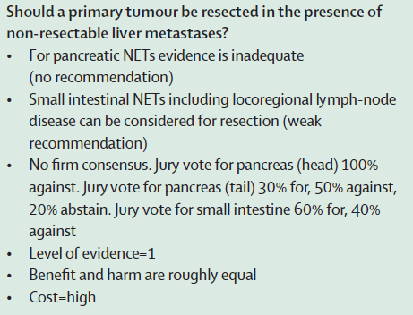
In a patient with metastatic non-functioning pancreatic NET should we resect the primary tumor?
Consensus Conference of the E-AHBPA- European-African Hepato-Pancreato-Biliary Association, Dec 12-13 2012, London
Patients with unresectable pancreatic neuroendocrine liver metastases might benefit from primary tumor resection if low surgical mortality is assured

Slide 14
In a patient with metastatic non-functioning pancreatic NET should we resect the primary tumor?
Survival in metastatic NFpNET survival is counted in years, not in months, as in other metastatic diseases, and eventually the primary tumor will cause upper digestive obstruction or biliary obstructions -> resection could be indicated for palliative reasons – A recent study showed several hospital admissions for primary related tumor complications for patients in whom primary tumor was not resected due to oncologic considerations (1)
The guidelines of the European Neuroendocrine Tumor Association and North American Neuroendocrine Tumor Association currently do not make any recommendations on whether the priamry tumor should be removed in this clinical scenario (2,3)
(1) Solorzano CC, Lee JE, Pisters PWT, Vauthey JN, Ayers GD, Jean ME, Gagel RF, Ajani JA, Wolff RA, Evans DB. Nonfunctioning islet cell carcinoma of the pancreas: survival results in a contemporary series of 163 patients. Surgery 2001; 130(6):1078–85.
(2) Kulke MH, Anthony LB, Bushnell DL, de Herder WW, Goldsmith SJ, Klimstra DS, et al. NANETS treatment guidelines: well-differentiated neuroendocrine tumors of the stomach and pancreas. Pancreas 2010;39:735-52.
(3) Pavel M, Baudin E, Couvelard A, Krenning E, Oberg K, Steinmuller T, et al. ENETS Consensus Guidelines for the management of patients with liver and other distant metastases from neuroendocrine neoplasms of foregut, midgut, hindgut, and unknown primary. Neuroendocrinology 2012;95:157-76.

Slide 15
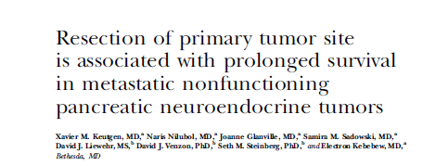

Slide 16
Of 882 patients with histologically confirmed NFpNET and distant metastases, 34% (303 of 882 patients) underwent resection of the primary tumor.
27% (83 of 303 patients) had additional resection of distant metastases
66% (579/882 patients) did not undergo resection of the primary site

Slide 17
Results
Patients who underwent resection of the primary pNET lived longer – 5,42 yrs than unresected patients (0,83 yrs) (p<0,0001)
Patients who underwent resection of both primary tumor and metastatic sites lived longer – 8,5 yrs than patients who underwent only resection of the primary tumor (5,58 yrs)
18 patients underwent removal of distant metastases only – median survival 5,33 yrs

Slide 18
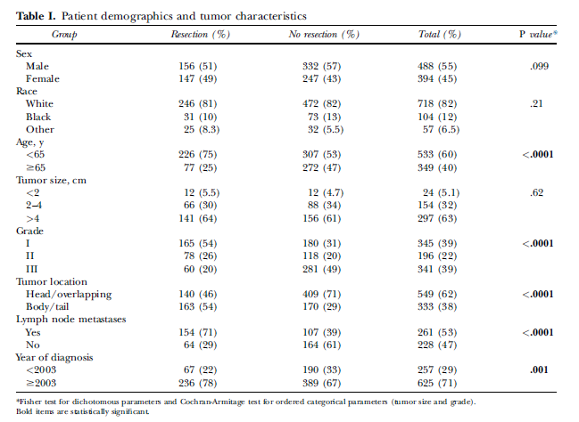
Who benefits the most?

Slide 19
Is there a benefit in resection for patients with grade III tumors?
341/882 patients had grade III tumors -> removal of the primary tumor was associated with greater survival – 1,25 yrs than patients without operative intervention – 0,25 yrs
The resection benefit is maximal for grade I-II tumors but persists at a lower extent for grade III tumors

Slide 20
In a patient with metastatic non-functioning pancreatic NET should we resect the primary tumor?
Resection of both primary tumor and metastases is ideal and offers the best survival
In case of unresectable metastases resection of primary tumor seems to offer a survival advantage
In G III tumors a survival advantage seems to exist but decision should be carefully made considering potential morbidity

Slide 21
Surgery in patients with locally advanced/vascular invasive pNETs

Slide 22
Should we perform surgery in patients with locally advanced/vascular invasion pNETs?
There are no systematic studies discussing the role of vascular reconstruction in patients with locally advanced pNETs
There are few reports on this matter, small series or case reports
An even trickier question is whether such resections should be attempted in the presence of liver mets

Slide 23
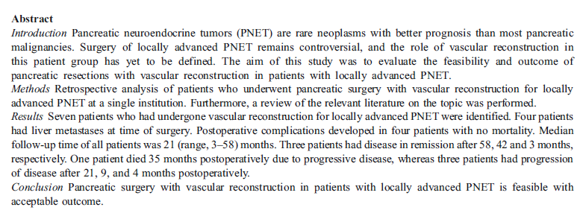
Should we perform surgery in patients with locally advanced/vascular invasion pNETs?

Slide 24
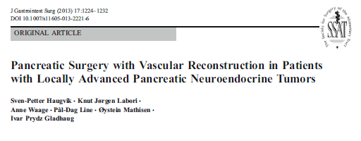
Seven patients with vascular resections from April 2007 to July 2012
In the same period 57 patients underwent pancreatic resection with vascular reconstruction for pancreatic adenocarcinoma
Inclusion criterium: Ki67<20%
Four patients had liver mets at time of surgery

Slide 25
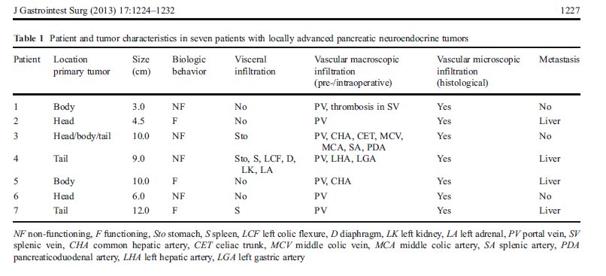

Slide 26
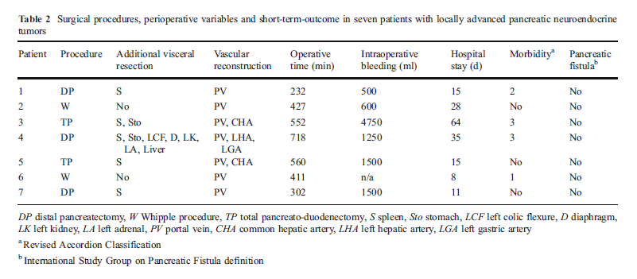
Is vascular resection safe?

Slide 27
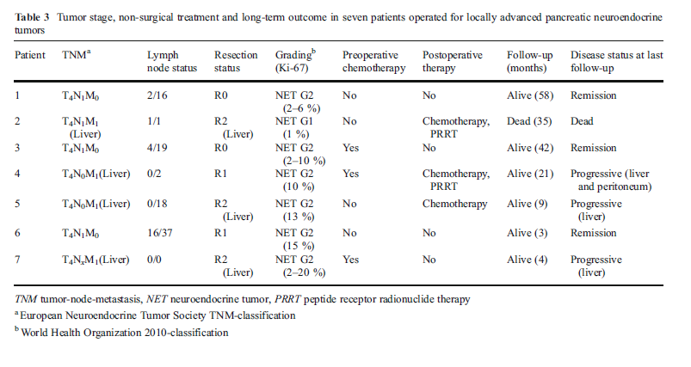
Does vascular resection bring survival benefit?

Slide 28
Complex surgery was safe with low morbidity and no mortality
None of the patients developed pancreatic fistula
All four patients with liver mets at time of surgery developed recurrence regardless whether liver resection was performed or not
None of the other patients developed recurrence during the study time
An acceptable survival was obtained even for patients with R2 (liver mets not resected) resection

Slide 29
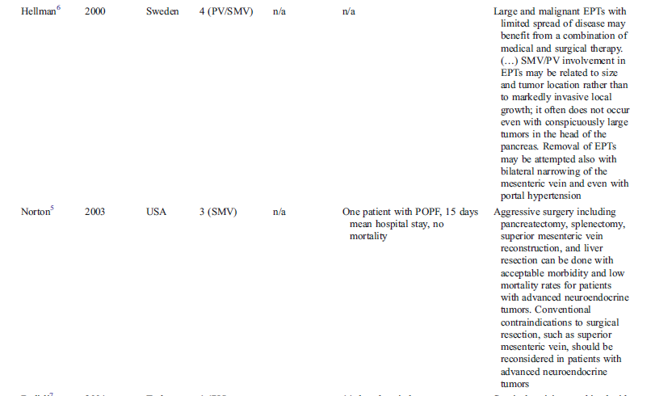
Should we perform surgery in patients with locally advanced/vascular invasion pNETs?

Slide 30
Should we perform surgery in patients with locally advanced/vascular invasion pNETs?

Slide 31
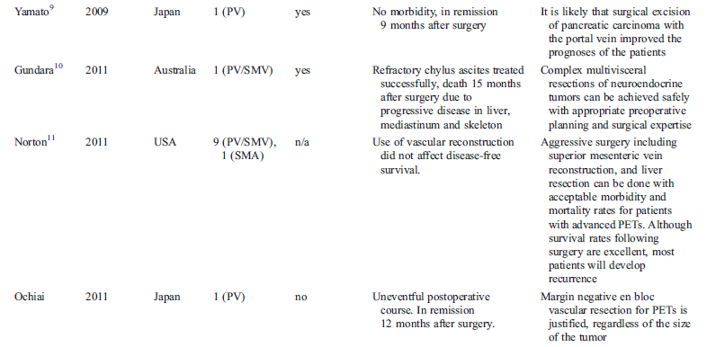
Should we perform surgery in patients with locally advanced/vascular invasion pNETs?

Slide 32
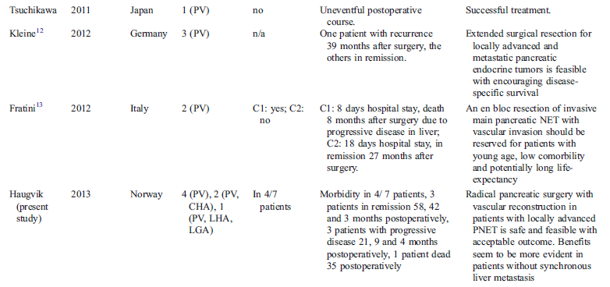
Should we perform surgery in patients with locally advanced/vascular invasion pNETs?

Slide 33
Should we perform surgery in patients with locally advanced/vascular invasion pNETs?
pNETs are rare tumors and published material on this particular matter is scarce
Case reports/ small series represent an observational study that reports on data from a subject group without a comparison population and represents level IV evidence
However case reports and case series are often the first data alerting to new treatment opportunity
According to available data aggressive surgery for locally invasive pNETs is safe and may bring survival benefit.

Slide 34
Hepatic resection in pNET

Slide 35
Hepatic resection for synchronous liver metastases from pNET
Simultaneous resection of both primary tumor and hepatic metastases can be performed in selected patients with acceptable rates of postoperative morbidity and mortality
Unfortunately, this is feasible in less than 20% of cases due to the high number of patients presented multiple, bilobar metastases
When achievable, the 5-year survival rate is 73% (1)
(1) Pamela J. Hodul, MD, Jonathan R. Strosberg, MD, and Larry K. Kvols, MDAggressive Surgical Resection in the Management of Pancreatic Neuroendocrine Tumors: When Is It Indicated?

Slide 36
When should a liver resection be done?
Grade 1or 2 tumors
When no evidence of non-resectable extrahepatic disease exists
R0 or R1 resection with an anticipated liver remnant of at least 30%
No evidence of carcinoid heart disease exists
Access to hepatic surgery center is possible

Slide 37
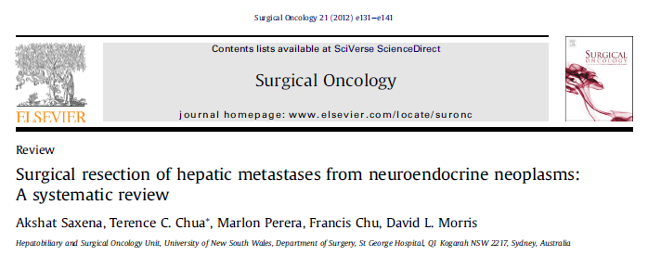
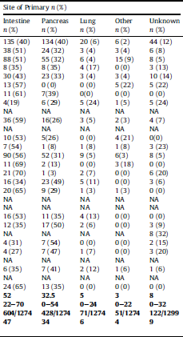
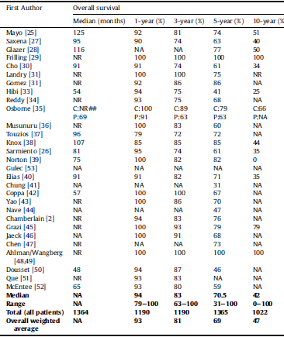

Slide 38
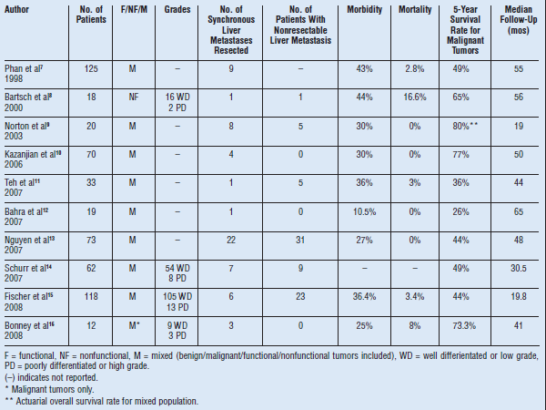
Hepatic resection for synchronous liver metastases from pNET

Slide 39
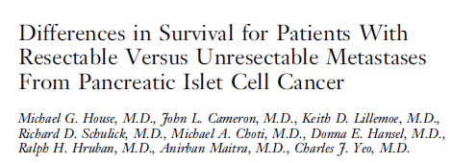
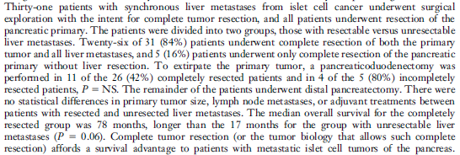
Hepatic resection for synchronous liver metastases from pNET

Slide 40
31 patients with synchronous liver-only metastases from pNET underwent resection with curative intent (resection of both the primary tumor and liver metastases) at The John Hopkins Hospital between 1988-2003
The outcomes of the 31 patients were compared to those of five cases who were diagnosed with unresectable liver metastases who were submitted to palliative pancreatic resection only

Slide 41
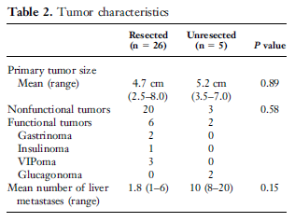
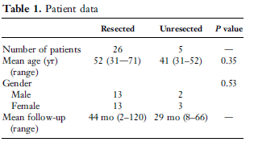

Slide 42
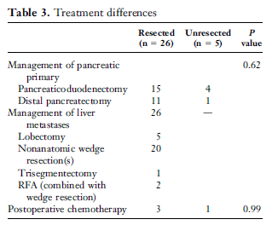
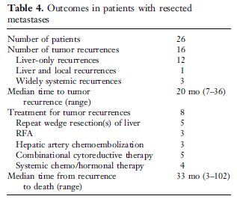

Slide 43
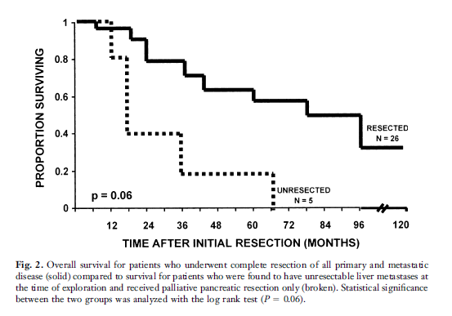

Slide 44
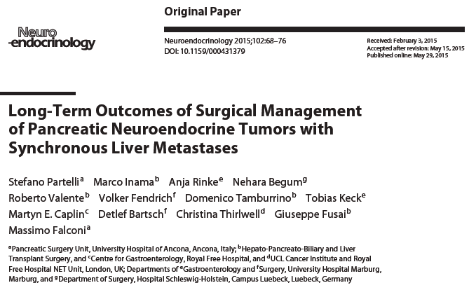

Slide 45
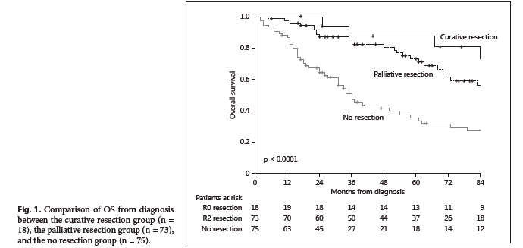
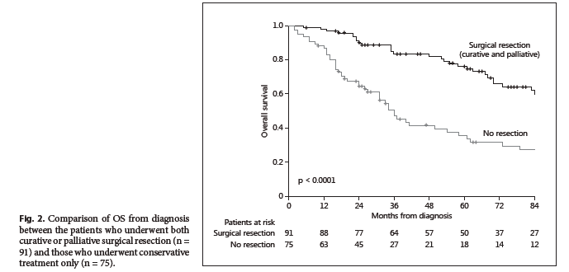

Slide 46
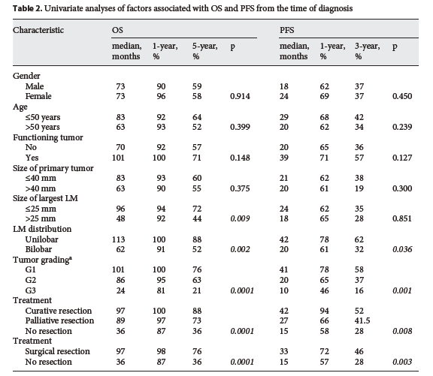

Slide 47
Hepatic resection for synchronous liver metastases from pNET
Sarmiento et al conducted a study on 23 patients submitted to concurrent pancreatic and metastatic liver resection
In all cases distal pancreatectomy was performed
Six major hepatectomies (>3 segments) and 17 minor hepatectomies (<3 segments) were associated
Complete gross resection (>90%) was achieved in 14 patients
No postoperative death was reported
Morbidity rate was 18%
5-year progression free survival was 5%
5-year symptom free survival was 24%
5-year survival rate was 71%

Slide 48
Hepatic resection for synchronous liver metastases from pNET
These data suggest that concurrent resection of pNETs and liver metastases is feasible and increases survival
However, due to the fact that disease progression is frequent, adjuvant therapy should be taken in consideration (1)
(1) Sarmiento JM, Que FG, Grant CS, et al. Concurrent resections of pancreatic islet cell cancers with synchronous hepatic metastases: outcomes on an aggressive approach. Surgery. 2002;132(6):976-982; discussion 982-983.

Slide 49
Hepatic resection for metachronous liver metastases from pNETs
Data are even scarcer, only few cases being reported so far
In Nguyen’s study regarding the role of surgery in malignant pNETs the author included 73 patients were included
Among these cases 4 patients experienced liver recurrence, two cases being submitted to re-resection

Slide 50
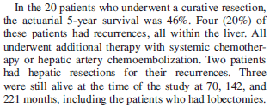

Slide 51
Hepatic resection for metachronous liver metastases from pNETs
In a similar study conducted by Ito and published in 2010, 73 patients with pNETs were included
48 cases were submitted to an R0/R1 resection (the remnant cases being submitted to biopsy/palliative procedures)
Among these 48 cases recurrence occurred in 10 cases, six of them being liver recurrences
Other sites of recurrences included the remnant pancreas (two cases), and retroperitoneal lymph nodes (one case)
Liver recurrence was treated by surgery (1 case), RFA (1 case) and chemotherapy (4 cases)
All cases presenting pancreatic recurrence were submitted to pancreatic resection

Slide 52
Liver transplantation for unresectable pNET liver metastases

Slide 53
Liver transplantation for unresectable pNET liver metastases
Rationale for liver transplantation
The majority of NETs are metastatic at clinical diagnosis and the liver is the most frequent site of metastases (1); 60-70% of pNETs and 80-90% of midgut NETs are metastatic at initial diagnosis
Surgical resection is the first option but is feasible in 10-25% of cases
The 5 year tumor recurrence for patients with unilobar or single metastatic spread without evidence of extrahepatic disease is about 80% (2)
Resection is indicated only if > 90% of the tumor burden can be removed
Survival rate at 5 years following surgery is 61-76% (3)
5 year survival with untreated liver mets is 30-40%
For patients with unresectable liver metastases and without extrahepatic disease liver transplant might be an option
1. Pavel M, Baudin E, Couvelard A, Krenning E, O ¨ berg K, Steinmu ¨ller T, et al. ENETS consensus guidelines for the management of patients with liver and other distant metastases from neuroendocrine neoplasms of foregut, midgut, hindgut, and unknown primary. Neuroendocrinology. 2012;95:157–76.
2. Mazzaferro V, Pulvirenti A, Coppa J. Neuroendocrine tumors metastatic to the liver: how to select patients for liver transplantation? J Hepatol. 2007;47:460–6.
3. Yao KA, Talamonti MS, Nemcek A, Angelos P, Chrisman H, Skarda J, et al. Indications and results of liver resection and hepatic chemoembolization for metastatic gastrointestinal neuroendocrine tumors. Surgery. 2001;130:677–82.

Slide 54
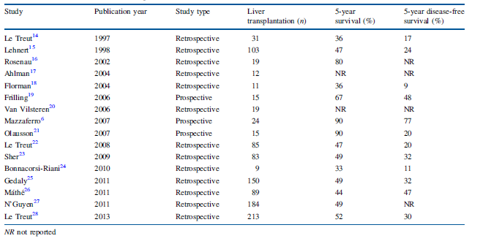
Liver transplantation for unresectable pNET liver metastases
Does it work?
Available studies on liver transplantation for neuroendocrine tumors in general

Slide 55
Liver transplantation for unresectable pNET liver metastases
Does it work?
Good 5 year survival for gastroenteropancreatic up to 90% (range 33-90%)
High risk of tumor recurrence with few patients free of tumor 5 years after LT

Slide 56
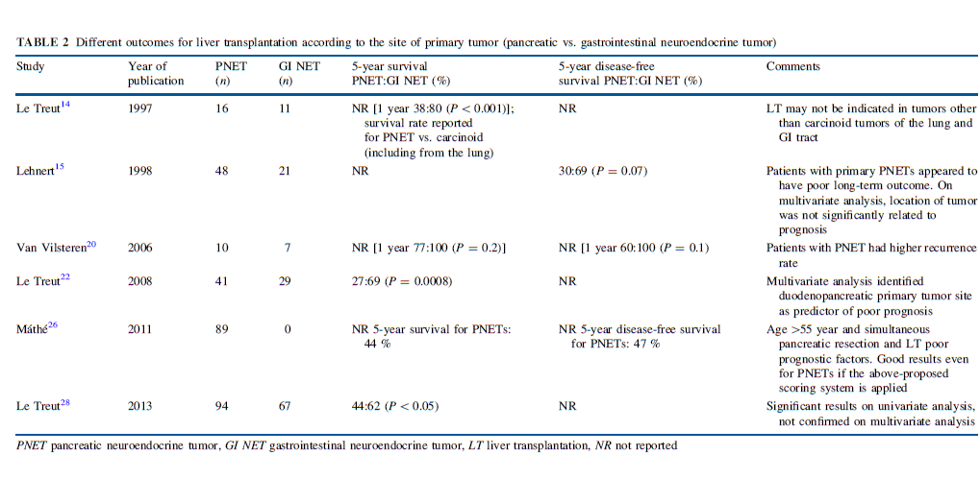
Liver transplantation for unresectable pNET liver metastases
Are liver mets originating from pancreatic NETs a different group among NET metastases?

Slide 57
Liver transplantation for unresectable pNET liver metastases
Are liver mets originating from pancreatic NETs a different group among NET metastases?
pNETs have a 5 year survival rate of 30-60% whereas gastrointestinal NETs show a survival rate of 60-90% (1,2)
(1) Panzuto F, Nasoni S, Falconi M, Corleto VD, Capurso G, Cassetta S, et al. Prognostic factors and survival in endocrine tumor patients: comparison between gastrointestinal and pancreatic localization. Endocr Relat Cancer. 2005;12:1083–92.
(2) Tomassetti P, Campana D, Piscitelli L, Casadei R, Santini D, Nori F, et al. Endocrine pancreatic tumors: factors correlated with survival. Ann Oncol. 2005;16:1806–10.

Slide 58
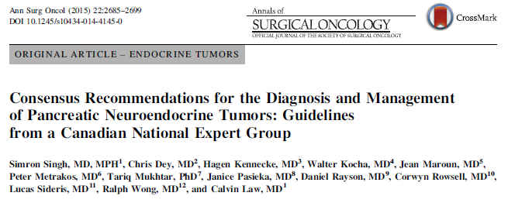
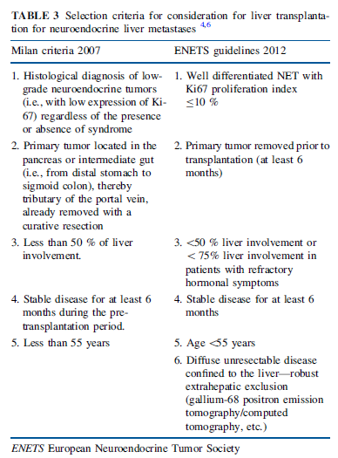
Liver transplantation for unresectable pNET liver metastases
Who benefits most?
Eligibility criteria:
Radiographic evidence of disease stability for a minimum of 6 months
Low grade disease without extrahepatic involvement
Age younger than 55 years

Slide 59
Consensus Conference of the E-AHBPA- European-African Hepato-Pancreato-Biliary Association, Dec 12-13 2012, London

Slide 60
When should a liver transplantation be done?
Liver mets from NETs are an accepted indication for liver transplantation because most often they show a low biological aggressiveness and indolent growth
5-year overall survival rates are comparable with those reported after LT for hepatocarcinomas

Slide 61
When should a liver transplantation be done?
When should a liver transplantation NOT be done?
Poorly differentiated tumors
Non-portal system tumor drainage
Extrahepatic metastases (apart from perihylar lymph nodes)
Severe carcinoid heart disease

Slide 62
Liver transplantation for unresectable pNET liver metastases
Prognostic factors for recurrence after LT for NETs
Time on the waiting list for LT – assessment of the biological behavior of the tumor (Gedaly et al described better outcomes for patients who waited more than 2 months before LT)
KI67 – a strong prognostic factor – Rossi et al retrospectively divided patients from 4 series (1-4) in two groups – low risk group (Ki67<2%) and a high risk group (Ki67>2%). Low risk patients had better one and three year survival and better disease free survival in comparison with high risk patients with only 17% of high risk patients free from recurrence at three years versus 52% of low risk patients
(1) Rosenau J, Bahr MJ, von Wasielewski R, Mengel M, Schmidt HH, Nashan B, et al. Ki67, E-cadherin, and p53 as prognostic indicators of long-term outcome after liver transplantation for metastatic neuroendocrine tumors. Transplantation. 2002;73:386–94.
(2) Ahlman H, Friman S, Cahlin C, Nilsson O, Jansson S, Wangberg B, et al. Liver transplantation for treatment of metastatic neuroendocrine tumors. Ann N Y Acad Sci. 2004;1014:265–9.
(3) Van Vilsteren FG, Baskin-Bey ES, Nagorney DM, Sanderson SO, Kremers WK, Rosen CB, et al. Liver transplantation for gastroenteropancreatic neuroendocrine cancers: defining selection criteria to improve survival. Liver Transpl. 2006;12:448–56.
(4) Olausson M, Friman S, Herlenius G, Cahlin C, Nilsson O, Jansson S, et al. Orthotopic liver or multivisceral transplantation as treatment of metastatic neuroendocrine tumors. Liver Transpl.2007;13:327–33

Slide 63
Liver transplantation for unresectable pNET liver metastases
Treatment options following recurrence after LT
RFA
TAE
TACE
Liver resection – theoretically an option, no data available in the setting of NETs
Radionuclid targeted therapy if somatostatin receptor functional imaging is avid
Provided the graft is well vascularised

Slide 64
Extrahepatic extrapancreatic resections in pNET

Slide 65
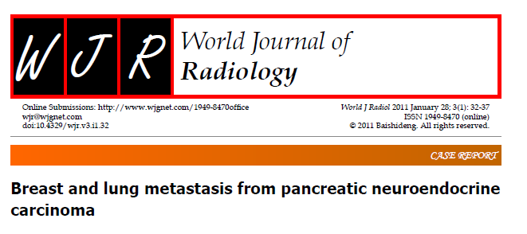
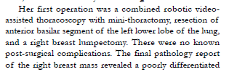
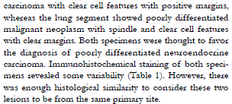
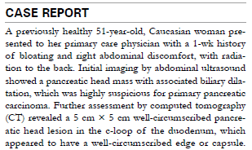
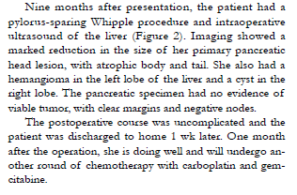
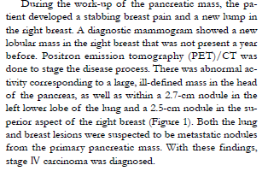
Extrahepatic extrapancreatic pNETs metastases
Other oligometastases such as breast metastases have been reported so far.

Slide 66
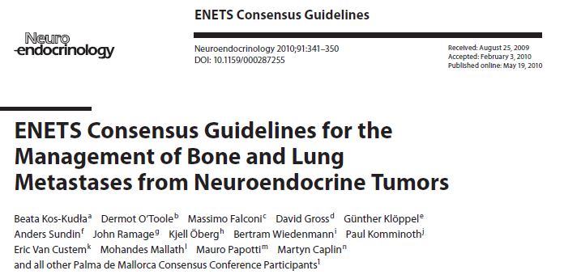
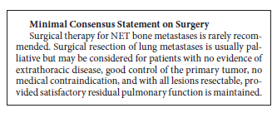

Slide 67
Peritoneal metastases from pNETs (PM)
PM are considered a poor prognosis factor for almost all malignancies; however, in PM from NETs a more favorable outcome has been advocated
NET derived PM arise mainly from midgut tumors and are usually associated with other sites of distant metastases, notably liver metastases and lymph node metastases
PM is reported in up to 17% of patients with NETs (1)
Cytoreductive surgery is recommended in exceptional cases with limited visceral disease, small volume peritoneal disease and resectable primary and peritoneal tumors.
Hyperthermic intraperitoneal chemotherapy (HIPEC) is not recommended for pNETs due to the lack of evidence (1-3)
1. Elias D, Sideris L, Liberale G, et al. Surgical treatment of peritoneal carcinomatosis from well-differentiated digestive endocrine carcinomas. Surgery. 2005;137:411–6. doi:10.1016/j. surg.2004.11.007.
2. Elias D, David A, Sourrouille I, et al. Neuroendocrine carcinomas: optimal surgery of peritoneal metastases (and associated intraabdominal metastases). Surgery. 2014;155:5–12. doi:10. 1016/j.surg.2013.05.030.
3. Kianmanesh R, Ruszniewski P, Rindi G, et al. ENETS consensus guidelines for the management of peritoneal carcinomatosis from neuroendocrine tumors. Neuroendocrinology. 2010;91:333–40. doi:10.1159/000286700

Slide 68
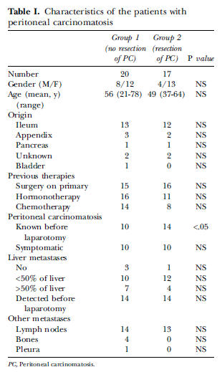
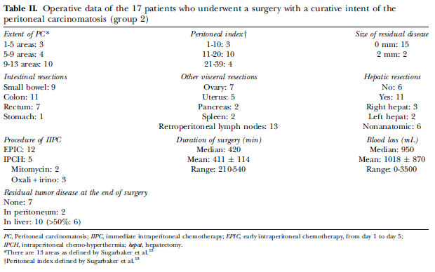
- Among 111 patients submitted to surgery for progressive well differentiated endocrine carcinomas, 37 cases (33%) presented a histologically proven PC, with synchronous liver metastases in 36 of them

Slide 69
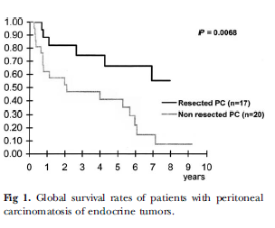
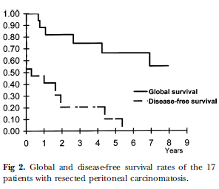
5 year survival rate – 40.9% for patients who did not undergo PM resection and 66.2% for those submitted to PC resection
Overall, 10% of patients were disease free 5 years after surgery
Among patients submitted to PM resection the main causes of death were liver failure (in four cases followed by bowel obstruction ( due to recurrent PM – in one case)

Slide 70
PM
The results reported by Elias and co regarding the role of PC resection in patients with endocrine carcinomas and published in 2005 were completed by the ones reported by the same team and published nine years later

Slide 71
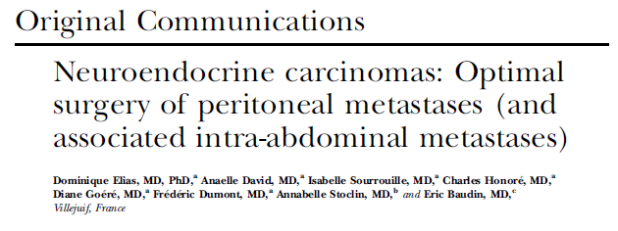
Is there a benefit in adding HIPEC?
41 patients with NET and PM were submitted to cytoreductive surgery between 1994-2012 at Gustave Roussi Cancer Campus, Villejuif, France
HIPEC was associated in 28 cases
Liver mets were treated during the same operative procdure in 66% of cases

Slide 72
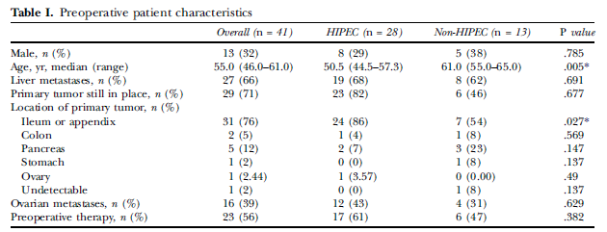

Slide 73
5-year and 10-year OS for the entire cohort were 69% and 52% respectively
Peritoneal metastases (PM) free survival rates were 43% at 5 years and 19% at 10 years
Liver metastases free survival rates were 34% at 5 years and 11% at 10 years
Overall survival rates were similar among HIPEC and non-HIPEC patients ( 1 year and 2 year survival rates of 89% and 81% in the HIPEC group versus 88% and 73% in the non-HIPEC group
Peritoneal recurrence rates were similar between HIPEC and non-HIPEC groups

Slide 76
Hepatically directed locoregional therapies

Slide 77
Hepatically directed locoregional therapies
Embolization (chemo/radio embolization) and ablation (radiofrequency/ microwave and cryoablation) represent additional, accepted techniques for the treatment of metastatic pNETs
Their combination with the standard surgical approach significantly increases survival (median 5 year survival rate>70%) (1)
(1) Mayo SC, de Jong MC, Bloomston M, et al. Surgery versus intraarterial therapy for neuroendocrine liver metastasis: a multicenter
international analysis. Ann Surg Oncol. 2011;18:3657–65. doi:10.
1245/s10434-011-1832-y.

Slide 78
Local ablation
Radiofrequency ablation -> the most popular procedure
Cryotherapy
Microwave coagulation
Ethanol injection
These procedures can be performed:
Percutaneously
During surgical procedures

Slide 79
Local ablation
Low morbidity rates – 5-15%, most frequent complications including liver abscesses or hematomas
Successful local control of liver metastases -85-95%
Symptom improvement (in functional, secretant tumors)- 90%
In one of the largest published case-series the 5 year survival rate was 48% (comparable to surgical resection) (1)
The main advantage – it can be applied in a repetitive manner, once new metastases are diagnosed
(1) Mazzaglia PJ, Berber E, Milas M, et al. Laparoscopic radiofrequency ablation of neuroendocrine liver metastases: a 10-year experience evaluating predictors of survival. Surgery 2007;142:10-9.

Slide 80
Transarterial embolization (TAE)/ Transarterial chemoembolization (TACE)
TAE – palliative therapy in patients with liver metastases not amenable to surgical resection/ablation
Performed via angiography
Embolization may be performed alone (transarterial embolization – TAE) or in association with chemotherapy (transarterial chemombolization – TACE)
Absolute contraindication: portal vein thrombosis, ascites, liver failure
Relative contraindication: >50% tumoral liver involvement
Tumor response rate varies between 35-80%
Symptomatic response: 70-100%
Overall survival: 20-36 months (1).
(1) Gupta S, Johnson MM, Murthy R, et al. Hepatic arterial embolization and chemoembolization for the treatment of patients with metastatic neuroendocrine tumors: variables affecting response rates and survival. Cancer 2005;104:1590-602.

Slide 81
Radioembolization
Selective distribution of radioactive Ytrium-90 microspheres into the peri-tumoral blood vessels
Unlike TAE/TACE, tissue ischemia does not represent the goal of this therapy, so the sparing of normal liver tissue is more efficient using this technique
Can be used in patients presenting a higher proportion of liver metastases (compared to TAE/TACE)
Most dangerous postprocedural complications include: acute hormone release, acute liver failure, tumor lysis syndrome, post-mbolization syndrome, radiation pneumonitis
Median survival rate reaches 70 months (1)
(1) Kennedy AS, Dezarn WA, McNeillie P, et al. Radioembolization for unresectable neuroendocrine hepatic metastases using resin 90Y-microspheres: early results in patients. Am J Clin Oncol 2008;31:271-9.

Slide 83
most studies demonstrated that pNETs report a poorer outcome in terms of survival after radio or chemoembolization (when compared to carcinoid tumors)
Other negative prognostic factors are represented by the male gender, extended hepatic disease and the presence of extrahepatic lesions
However, in selected cases a benefit in terms of survival is acheivable

Slide 84
Downstaging/neoadjuvant treatment in pNETs

Slide 86
Should neoadjuvant and adjuvant treatment strategies be used?
Neoadjuvant and adjuvant treatment are not currently considered for hepatic resections
In a retrospective study involving 59% pNETs no difference in terms of survival was noted between treatment and non-treatment groups after liver resection or liver transplantation (1)
However, findings from case reports indicate that downstaging of neuroendocrine liver mets with immunochemotherapy or peptide receptor radionuclide therapy might increase the resecability of the liver lesions (2)
Maire F, Hammel P, Kianmanessh R et al Is adjuvant therapy ith streptozocin and 5FU useful after resection of liver metastases from digestive endocrine tumors? Surgery 2009; 145: 69-75
Sowa-Stazczak A, Pach, D, Cherzan R et al. peptide receptors radionuclide therapy as a potential tool for neoadjuvant therapy in patients with inoperable neuroendocrine tumors. Eur J Nucl Med Mol Imaging 2011; 38: 1669-74

Slide 88
When should peptide receptor radionuclide therapy be used?
Most gastroenteropancreatic NETs express somatostatin receptors and treatment with 90Y or 177Lu somatostatin analogues is feasible
Peptide receptor radionuclide therapy (PRRT) is extensively used since 1999 and induces disease stabilization; in the meantime an improved survival is also expected
Experts recommend it for the treatment of both hepatic and extrahepatic metastases

Slide 89
When should chemotherapy, targeted therapy or biotherapy be used?
High grade pNETs are amenable most to chemotherapy while slow growing lesions (grade1 and 2 NETs) are amenable to targeted therapies ( everolimus, sunitinib) and biotherapy (somatostatin, interferon)

Slide 91
Conclusions/General Overview

Slide 92
Conclusions/General Overview

