Slide 1
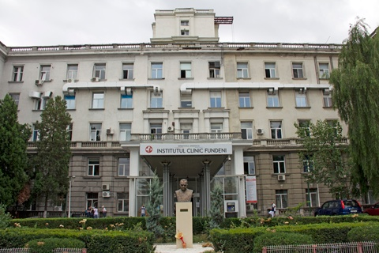
SURGICAL TREATMENT OF LIVER METASTASES FROM COLORECTAL CANCER
Sorin Alexandrescu, Andrei Diaconescu, Zenaida
Ionel, Cristian Zlate, Razvan Grigorie, Doina
Hrehoret, Vladislav Brasoveanu, Irinel Popescu
“Dan Setlacec” Center of General Surgery and Liver Transplantation, Fundeni Clinical Institute, Bucharest

Slide 2
CLMs TREATMENT - MULTIMODAL
Liver resection – the only potentially curative treatment
Ablative therapy – radiofrequency, microwaves, laser
Chemotherapy
Systemic
Loco-regional
Targeted therapies – monoclonal antibodies
Interventional radiology
Radioembolization – Yttrium-90 microspheres
Chemoembolization – DEBIRI

Slide 3
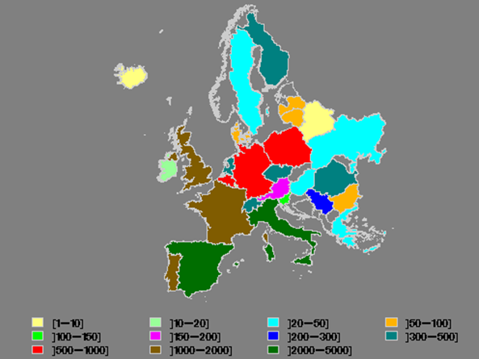
Treatment results
“Dan Setlacec” Center
of General Surgery and
Liver Transplantation,
Fundeni, Bucharest
Jul 2006 – Dec 2015
329 patients

Slide 4
Definition of resectability: “Practical” rather than “dogmatic”
Technical resectability
The anticipated ability to:
Achieve an R0 resection (R1 – by necessity)
Preserve two contiguous segments of liver
Preserve adequate vascular inflow, outflow and biliary drainage
FLR > 25-30%
Notes:
4
4

Slide 5
Pathways to resectability of liver metastases in CRC
Liver metastases
75% non-resectable
25% resectable
Active therapy
10–40% initially non-resectable
might become resectable (potential for conversion)
60–90% remain non-resectable
30-40% Resection
Potential
for cure

Slide 6
I. Initially resectable CLMs

Slide 7
1. SYNCHRONOUS CLMs
Primary tumor
resection
Liver
resection
Chemotherapy
Onco-surgical approaches:
Delayed liver resection
Simultaneous resection
“Liver-first” approach

Slide 8
1. Safety of the procedure

Slide 9
Theoretical assumptions
Staged resections – avoid the cumulative risks of two concomitant resections
Delayed liver resection (DR)
“Liver-first” approach
Simultaneous resection (SR)
Higher morbidity rates
Increased mortality rates
?

Slide 10
a. Simultaneous resection
234 patients
b. Staged resection
67 patients
1. Delayed liver resection
62 patients
2. “Liver-first” resection
5 patients
Dan Setlacec Center of General Surgery and Liver Transplantation, Fundeni

Slide 11
Morbidity rates
Simultaneous resection
staged
Resection
37.3% (87/234)
3.8% (9/234)
p = 0.1457
27.2% (18/67)
3% (2/67)
Mortality rates
p = 1
Dan Setlacec Center of General Surgery and Liver Transplantation, Fundeni

Slide 12
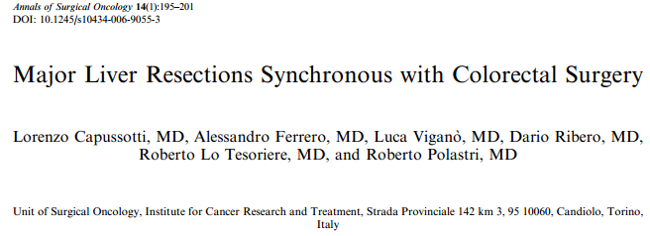
Simultaneous colorectal and hepatic resections are safe and should be performed for most patients with SCLMs

Slide 13
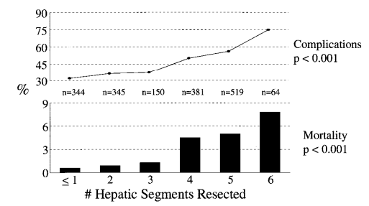
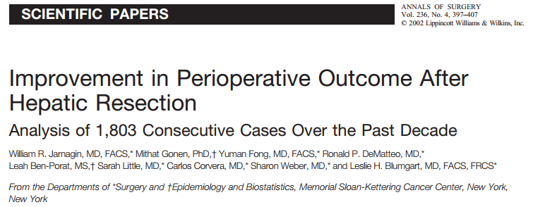
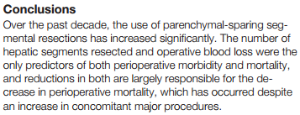
Predictors of perioperative morbidity & mortality
Number of hepatic segments resected
Operative blood loss
Reductions in both are
responsible for the
decrease in mortality,
which has occurred
despite an increase in
concomitant major procedures

Slide 14
Recent trends - decrease morbidity & mortality -
Parenchyma sparing hepatectomies
Ultrasound-guided limited liver resections
Reduce the morbidity and mortality rates
Allow safe liver re-resections for recurrent CLMs
Minimal invasive approach
Mainly for the primary tumor
Colon cancer – Laparoscopic resection
Rectal tumors – Robotic surgery

Slide 15
Minimal invasive approach in SCLMs
Rectal resection – robotic approach
Liver resection – right subcostal incision 8 patients
Colorectal resection – laparoscopic approach
Liver resection – right subcostal incision 6 patients
Colorectal resection – laparoscopic approach
Liver resection – laparoscopic approach 4 patients
MORBIDITY RATE: 27.7%(5/18)
MORTALITY RATE: 0%
Dan Setlacec Center of General Surgery and Liver Transplantation, Fundeni

Slide 16
2. Oncologic outcome

Slide 17
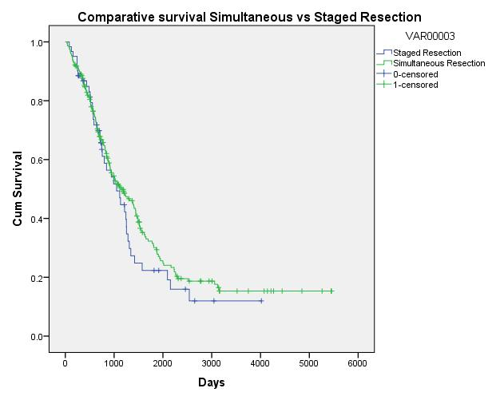
Overall survival rates
Simultaneous vs. Staged resection
p value = 0.352
SIMULTANEOUS
RESECTION
1-yr: 86.2%
3-yr: 51.6%
5-yr: 31.6%
median: 38.7 mo
STAGED
RESECTION
1-yr: 86.8%
3-yr: 49.4%
5-yr: 22.3%
median: 35.1 mo
Dan Setlacec Center of General Surgery and Liver Transplantation, Fundeni

Slide 18
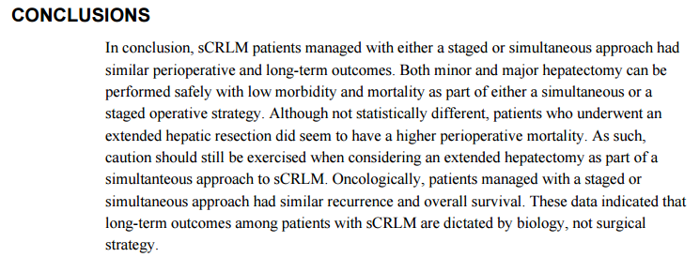
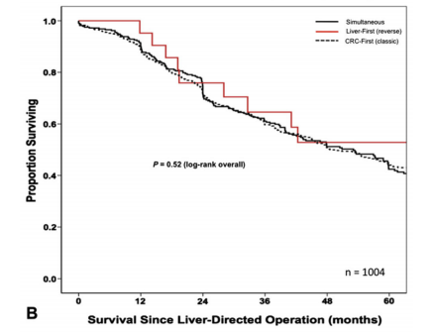
SCLMs patients managed with
either a staged or simultaneous
approach had similar perioperative
and long-term outcomes

Slide 19
Which approach, for whom?
Staged resection |  | Simultaneous resection
Delayed liver resection | “Liver-first” approach
Complications of the primary: - Perforation - Obstruction | Low and mid-rectum carcinoma Difficult major hepatectomies | All the other patients

Slide 20
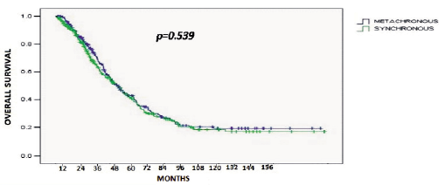
2. METACHRONOUS CLMs
232 patients
p value = 0.539
SYNCHRONOUS CLMs
1-yr: 86.3%
3-yr: 50.1%
5-yr: 30.1%
median: 38.1 mo
METACHRONOUS CLMs
1-yr: 89.6%
3-yr: 51.6%
5-yr: 31.8%
median: 39.6 mo
Dan Setlacec Center of General Surgery and Liver Transplantation, Fundeni

Slide 21
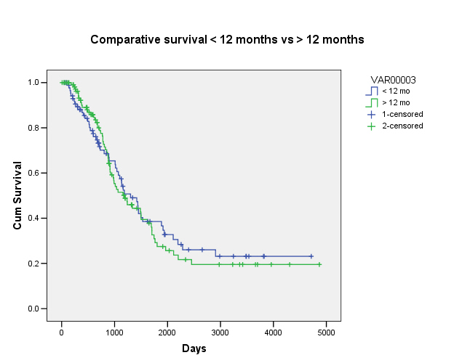
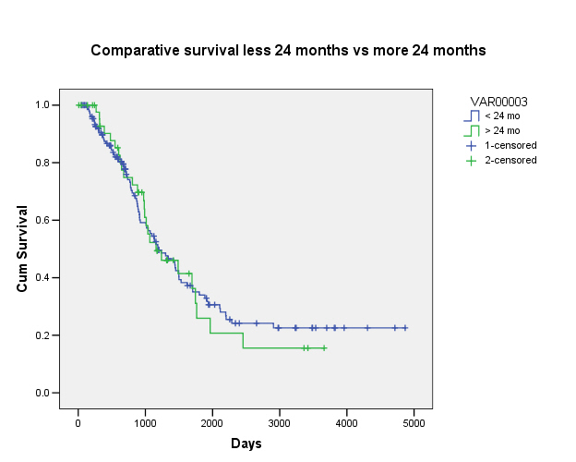
Does disease-free interval influence overall survival?
P = 0.796
P=0.867
The disease-free interval between the primary
tumor resection and CLMs development
has not any impact on overall survival

Slide 22
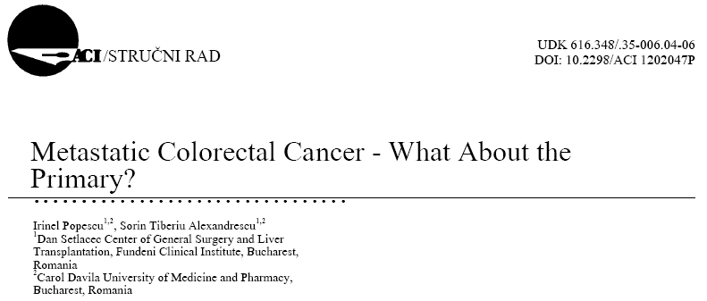
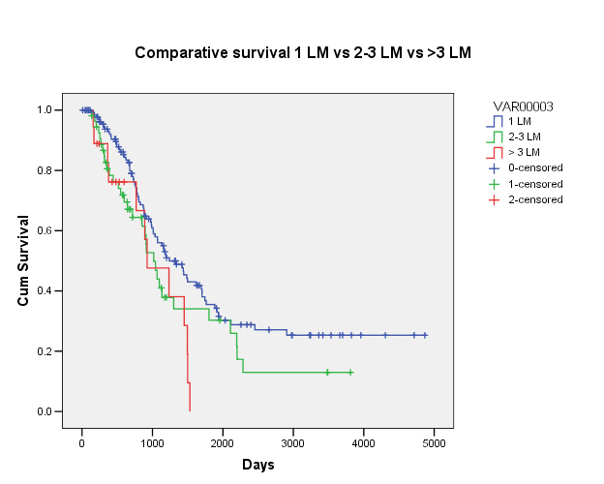
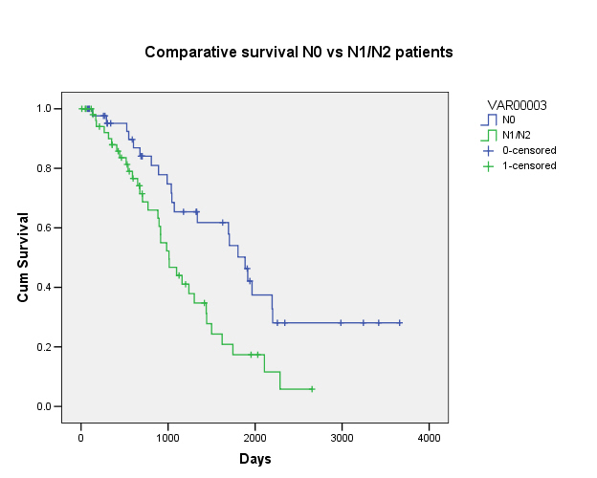
Prognostic factors
P = 0.029
P = 0.005
The number of metastases and lymph nodes status were correlated with overall survival

Slide 23
II. INITIALLY UNRESECTABLE CLMs

Slide 24
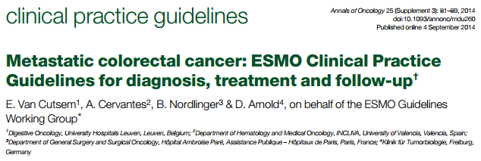
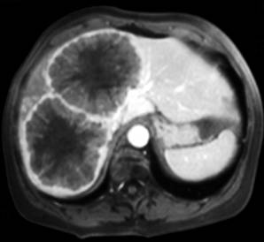
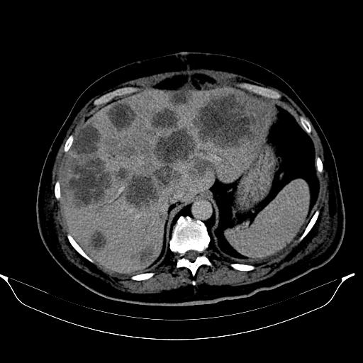
ESMO guidelines 2014
Patient Groups 1–3
Initially unresectable mCRC, including:
Potentially resectable (Group 1)
Disseminated disease, technically ‘never’/unlikely resectable (Group 2)
Never-resectable metastatic disease (Group 3)

Slide 25
Potentially resectable (Group 1)

Slide 26
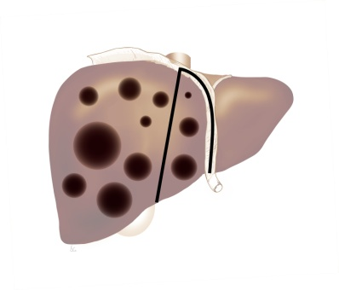
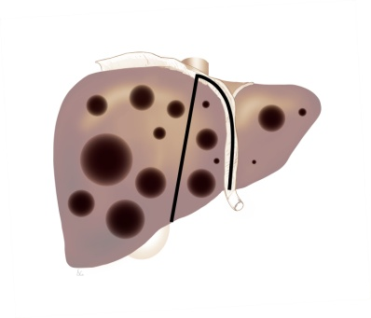
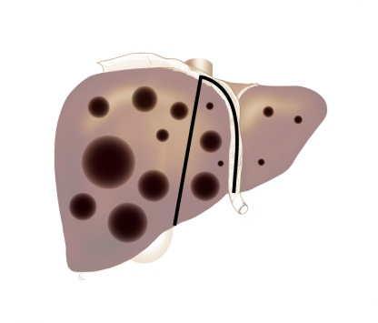
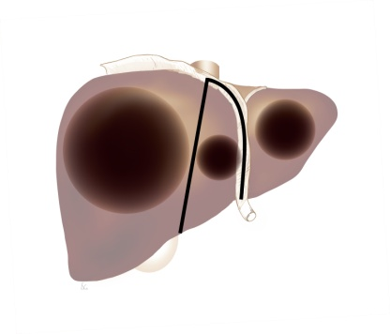
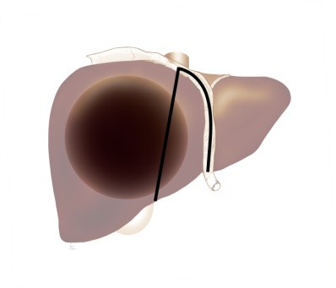
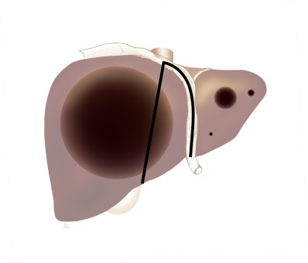
Strategies for render to resectability
A
B
C
D
Hepatectomy
+ Ablation
(CARe)
Hepatectomy following
PVE/PVL or ALPPS
“Two-stage”
Hepatectomy
+/– PVE/PVL
Hepatectomy
following
conversion CHT
11 pts.
5 pts.
25 pts.
4 pts.
FLR < 30%
Few LM >30 mm
in FLR
< 3 LM, < 30 mm
in FLR
Few bilobar
CLMs

Slide 27
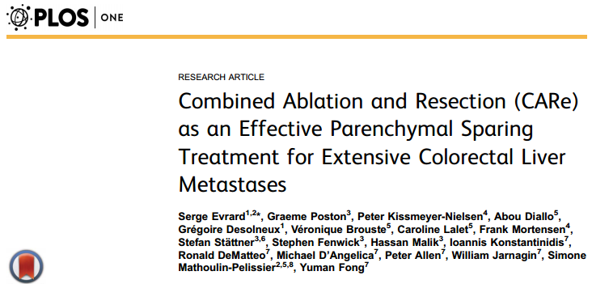
A. Combined Ablation and Resection (CARe)
Median number of metastases: 5 (73% synchronous; 89% bilateral)
100
90
Upper limit 95% CI
Survival %
Lower limit 95% CI
80
70
60
Survival (%)
50
40
30
Median OS: 39.6 mo
5-year OS: 37%
20
10
0
0
1
2
3
4
5
6
7
Years after treatment
CARe increases the chance of cure for patients with extensive CRC liver metastases

Slide 28
T C, f, 41 y-o
5. 2014
Sigmoid ADK – pT3N1bM0
Left colectomy with colo-rectostomy
7. -12. 2014
FOLFOX – 6 cycles
“Dan Setlacec” Center of General Surgery and Liver Transplantation

Slide 29
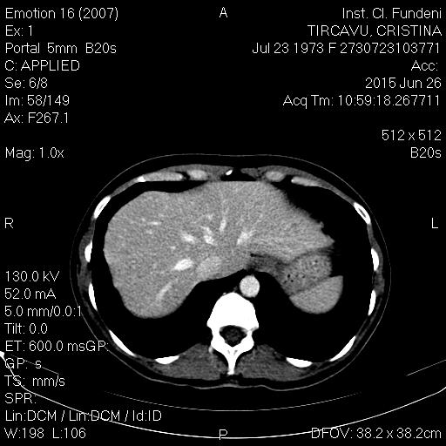
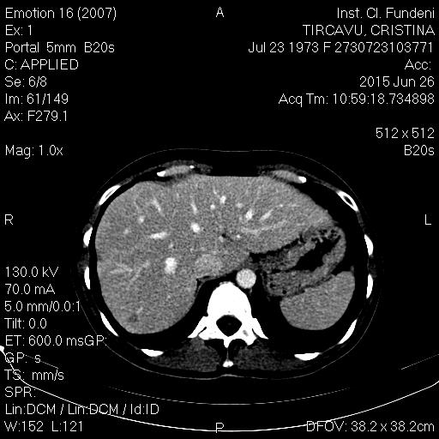
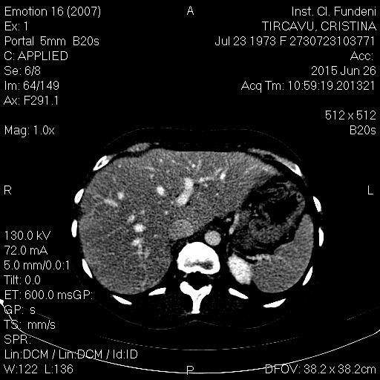
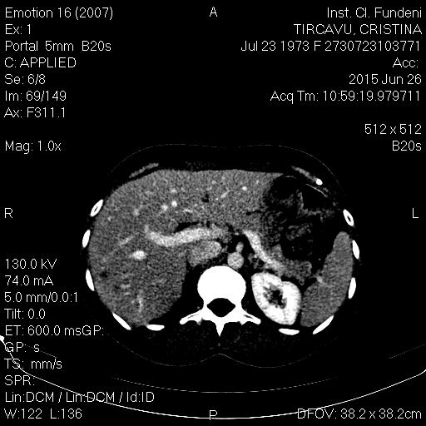
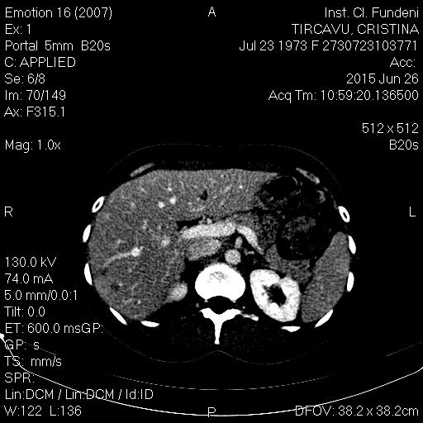
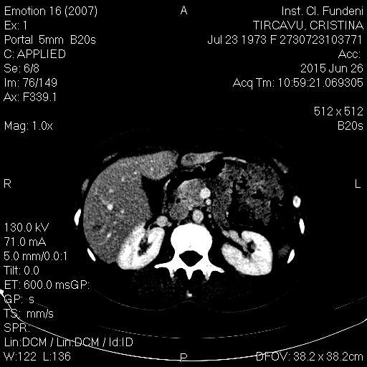
6. 2015
Multiple (12) bilobar CLMs

Slide 30
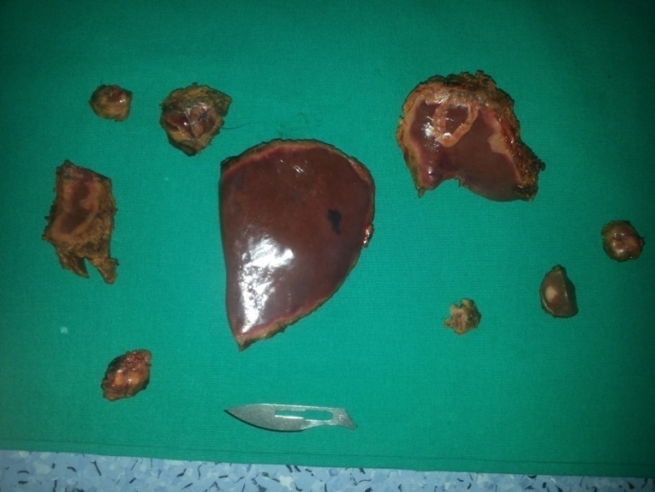
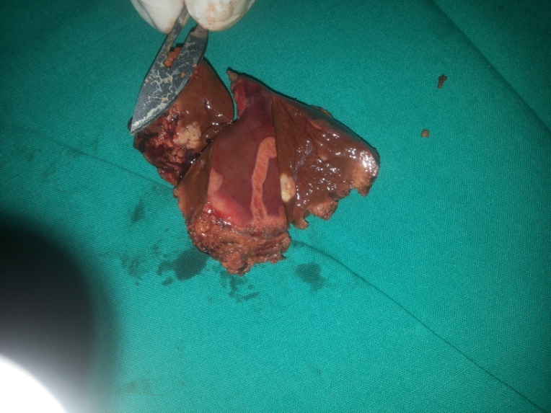
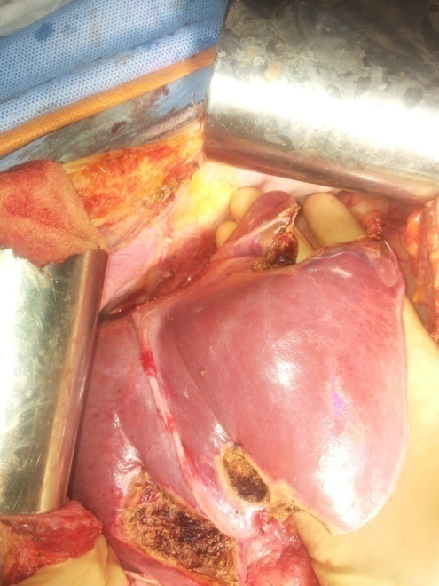
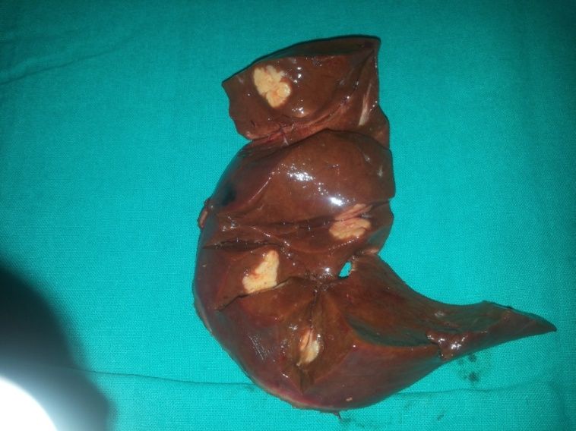
7. 2015
Intraoperative ultrasonography: 15 CLMs
Non-anatomical resections segments 2 and 6, wedge resections segments 3, 4, 7 and RFA (2 CLMs segment 8)

Slide 31
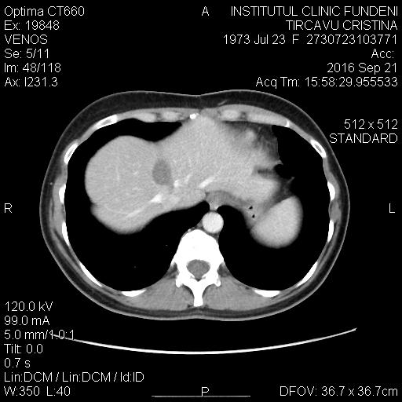
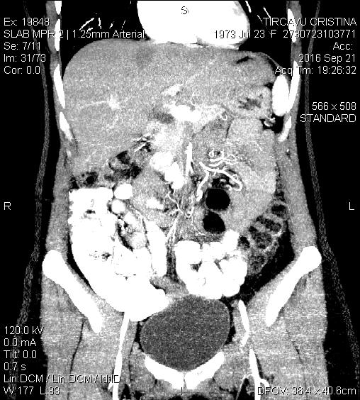
8. 2015 – 6. 2016: 5-FU+ Bevacizumab
Without recurrence, Complete ablation
In present: alive, without recurrence,
at 14 months postoperatively

Slide 32
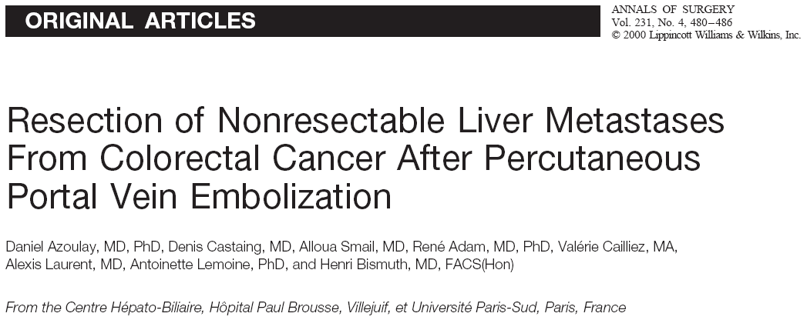
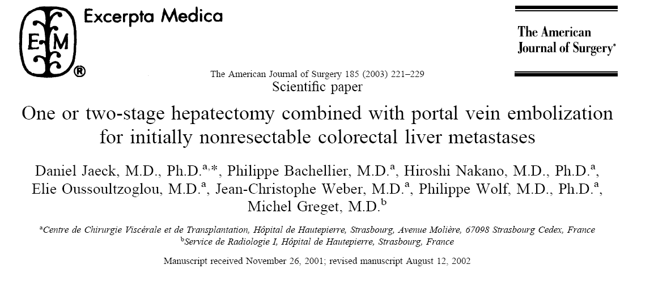
B. Hepatectomy after
PVE/PVL
Resectability rate^{1,2}: 55-63%
Morbidity rate^{1,2}: 7 – 29%
Mortality rate^{1,2}: 0 – 4%
5-yr OS¹ – 40%
Objectives:
Atrophy of tumoral liver parenchyma (future resected liver)
Compensatory hypertrophy of the non-tumoral liver parenchyma (future liver remnant – FLR)
Avoidance of the postoperative liver failure
Azoulay D, Castaing D, Smail A et al. in Ann Surg; 231(4): 480 – 486, 2000
Jaeck D, Bachellier P, Nakano H et al in Am J Surg; 185: 221 – 229, 2003

Slide 33
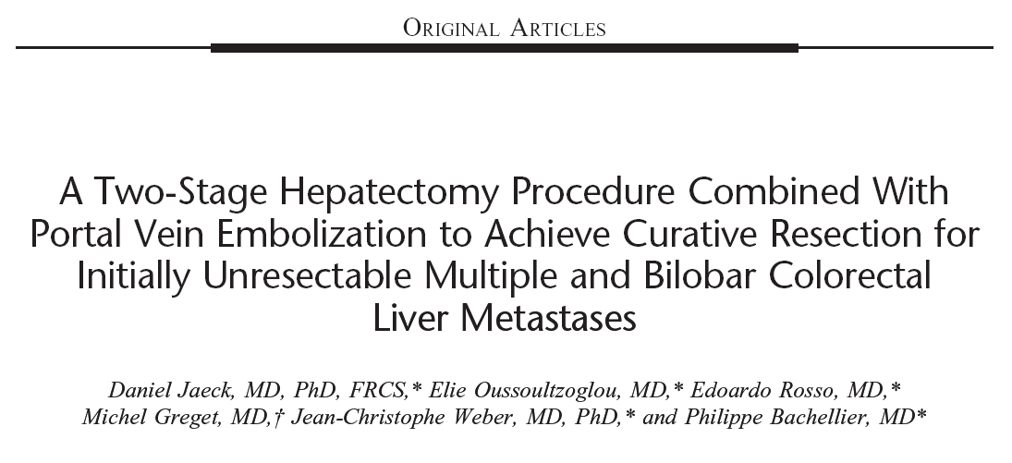
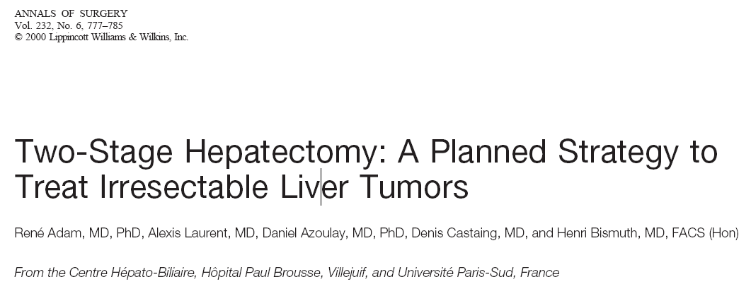
C. “Two-stage” liver resection +/- PVE/PVL
Resectability rate^{1,2}: 55 – 81%
Morbidity rate^{1,3}: 45%
Mortality rate¹⁻³: 0 – 15%
3-yr OS^{1,2}: 35 – 54%
Stage 1: resection of the metastases from the future liver remnant (left hemiliver or segments 2-3)
+/– PVE/PVL
Stage 2: resection of the tumoral liver – right hemihepatectomy/trisectonectomy
Adam R, Laurent A, Azoulay D et al. in Ann Surg; 232 (6): 777 – 785, 2000
Popescu I, David L, Brasoveanu V et al. in Magy Seb 58(3): 184-9, 2006
Jaeck D, Oussoultzoglou E, Rosso e et al. in Ann Surg; 240: 1037 – 1051, 2004

Slide 34
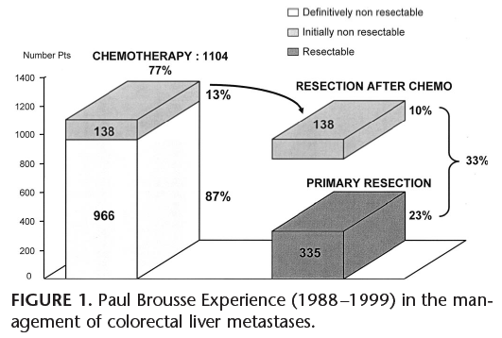
D. Hepatectomy following conversion chemotherapy
100
91%
Resectable : 335
Initially non resectable : 138
80
66%
P= 0.01
60
48%
Survival (%)
52%
30%
40
33%
20
23%
No Surgery
0
1
2
3
4
5
6
7
8
9
10
Years

Slide 35
M. V., f, 62 y-o
1. 2016
Obstructive superior rectal ADK,
liver metastasis segments 4,5,7,8
Anterior rectal resection
pT3N2(15/23)M1(hep)
RAS wild type
“Dan Setlacec” Center of General Surgery and Liver Transplantation

Slide 36
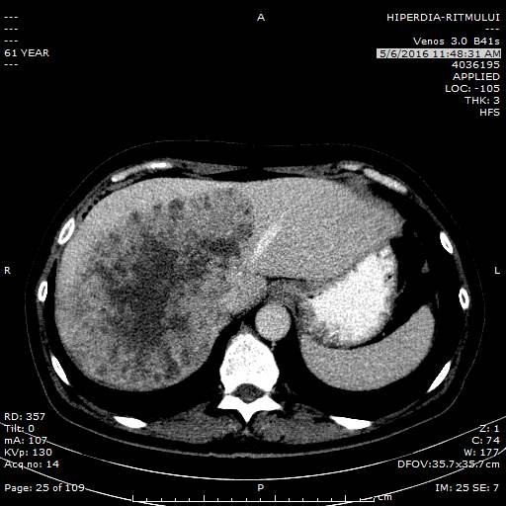
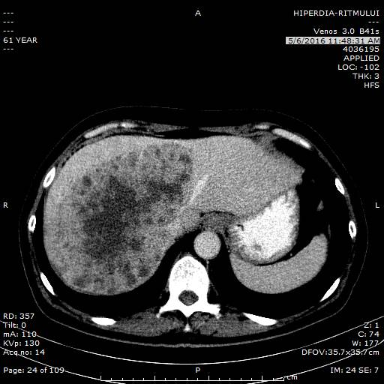
2. 2016 – 4.2016
FOLFOX – 3 cycles
Stable disease
CEA > 100 ng/ml
5. 2016

Slide 37
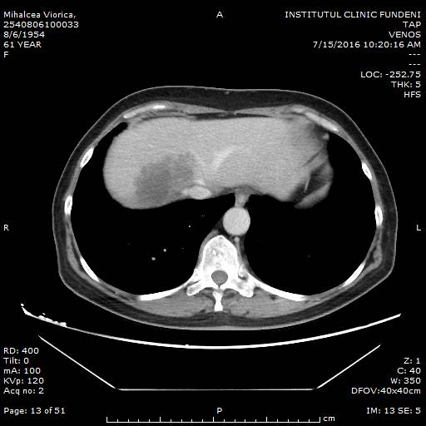
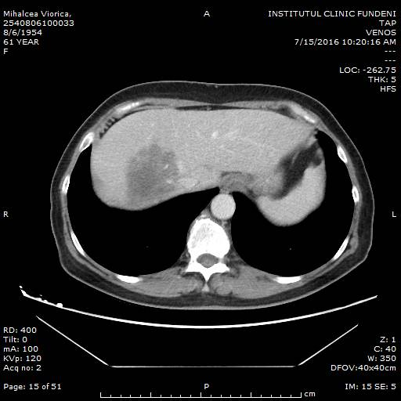
5. 2016 – 7.2016
FOLFOX + Cetuximab – 3 cycles
Important down-sizing of CLM
Early tumor shrinkage
CEA = 2.2 ng/ml
7. 2016

Slide 38
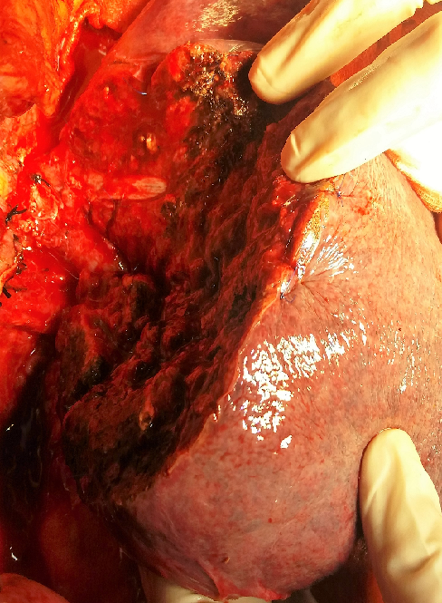
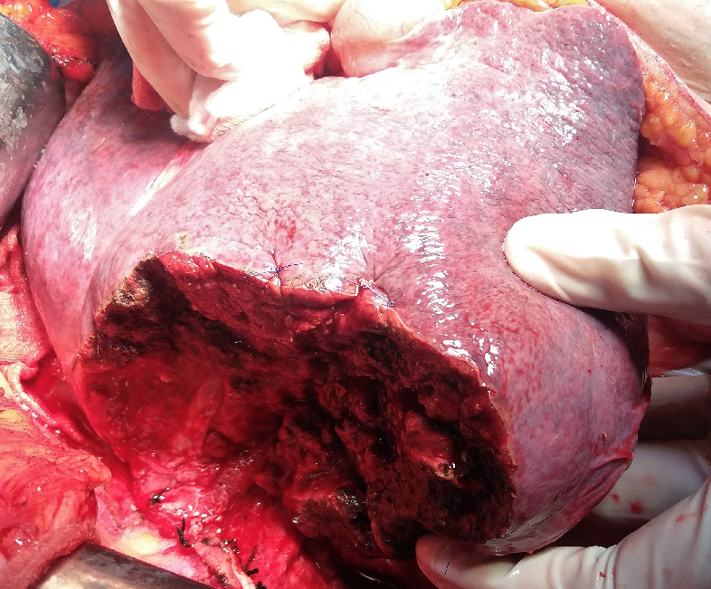
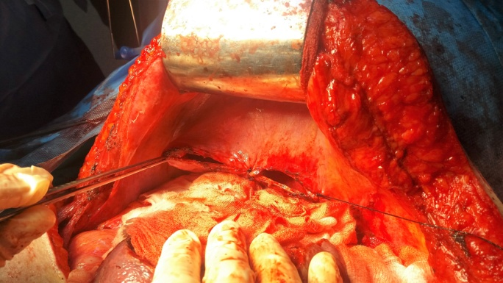
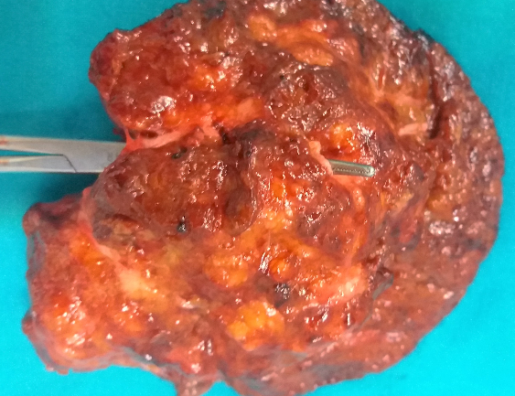
8. 2016
Liver resection of segments 7, 8, 4 with
Right hepatic vein resection and lateral resection of Middle hepatic vein,
Partial resection of the right diaphragm with phrenoraphy
No postoperative complications

Slide 39
Importance of initial definition of criteria for resectability
p = 0.006
Median resection rate:
Defined criteria for resectability – 39.5%
Without clearly defined criteria for resectability – 11%

Slide 40
“Dan Setlacec” Center of General Surgery and Liver Transplantation
Morbidity rates
INITIALLY
RESECTABLE
INITIALLY UNRESECTABLE
31.3% (167/533)
2.8% (15/533)
p = 0.020
48% (22/45)
4.4% (2/45)
Mortality rates
p = 0.634

Slide 41
Overall survival rates
Initially Resectable vs. Initially Unresectable CLMs
P=0.429
INITIALLY RESECTABLE
1-yr: 88.6%
3-yr: 51.8%
5-yr: 31.4%
median: 38.6 mo
INITIALLY UNRESECTABLE
1-yr: 92.6%
3-yr: 48.2%
5-yr: 19.3%
median: 36 mo

Slide 42
CONCLUSIONS
The progresses in liver surgery increased dramatically the survival rates of patients with CLMs
Simultaneous resection provides similar short-term and long-term outcomes as staged resections in most patients with synchronous CLMs
In resected metachronous CLMs, the disease-free interval between the primary tumor resection and CLMs diagnosis has not impact on overall survival

Slide 43
CONCLUSIONS
Whenever possible, major hepatectomies should be replaced by IOUS-guided limited liver resections, and primary tumor should be approached minimally invasive
Even in patients with initially unresectable CLMs, the prognosis is improved by an aggressive multimodal treatment (based on a multi-disciplinary team decision)
END

