Slide 1
HEPATIC RESECTION FOR PARENCHIMATOUS OVARIAN CANCER LIVER METASTASES BEYOND SECONDARY CYTOREDUCTION FOR RELPASED OVARIAN CANCER
Nicolae Bacalbasa¹, Irina Balescu², Simona Dima³,
Vladislav Brasoveanu³, Irinel Popescu^{1,3}
Carol Davila University of Medicine and Pharmacy, Bucharest, Romania
Ponderas Hospital, Bucharest, Romania
Dan Setlacec Center of Gastrointestinal Disease and Liver Transplantation, Fundeni Clinical Institute, Bucharest, Romania

Slide 2
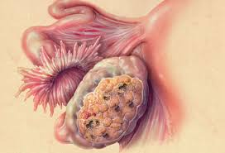
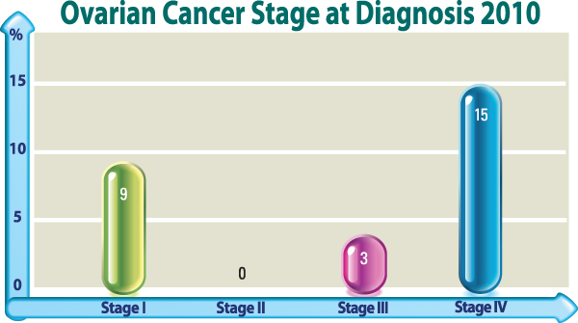
The magnitude of the problem
Ovarian cancer represents the leading cause of mortality among gynecologic cancers
Most cases are diagnosed in an advanced stage of the disease
Due to the increase of the life expectancy worldwide, the global incidence of ovarian cancer is estimated to increase with up to 20% in the next 20 years

Slide 3
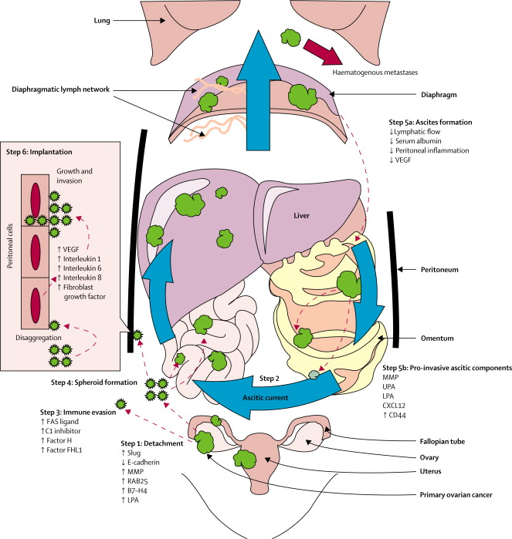
Patterns of spread
The main patterns of spread consist of
Peritoneal
Hematogenous
Lymphatic
route

Slide 4
Patterns of spread
Most cases are diagnosed in an advanced stage of the disease when disseminated lesions are already present
Upper abdominal involvement was associated with decreased rates of overall survival; however association of upper abdominal resection leaded to an increase of complete cytoreduction and an improvement of the overall survival

Slide 5
Debulking surgery for advanced stage ovarian cancer

Slide 7
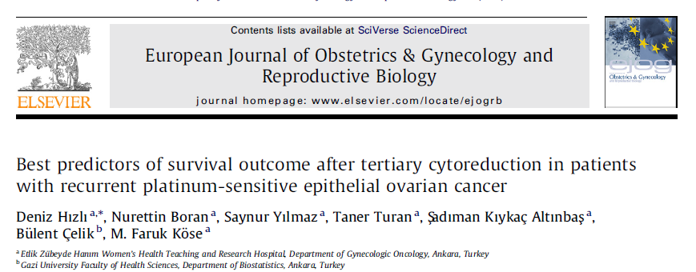
Debulking surgery for relapsed ovarian cancer

Slide 8

Debulking surgery for relapsed ovarian cancer
The benefits in terms of survival obtained at the moment of tertiary cytoreduction in cases in whom an R0 resection was achieved encouraged the surgeons to include aggressive surgical procedures such as liver resection in order to maximize the cytoreductive effort

Slide 9
Aim of the present study:
To evaluate the benefits of ovarian cancer liver metastases (OCLM) beyond secondary cytoreduction in patients with recurrent epithelial ovarian cancer

Slide 10
Material and methods:
Between January 2002 and April 2014 liver resections for OCLM were performed at the moment of:
Tertiary cytoreduction – three cases
Quaternary cytoreduction – two cases

Slide 11
Results – tertiary cytoreduction
At the moment of tertiary cytoreduction:
the mean age was 60 years (range 54-72 years)
the mean tumor diameter was 2,3 cm
R0 resection was performed in all cases
histological studies revealed the presence of serous epithelial ovarian cancer in all cases

Slide 12
Results – tertiary cytoreduction
Initial FIGO stage | IC | IIC | IIIC
Interval between primary and tertiary cytoreduction (months) | 91 | 59 | 14
No. of liver metastases | Unique | Unique | Multiple lesions
Type of liver lesions | Parenchimatous | Parenchimatous | Peritoneal
Type of liver resections | Major | Minor | Minor
Other associated visceral resections | - | Splenectomy, partial gastrectomy | Left colectomy, ureteral resection
Type of resection | R0 | R0 | R0

Slide 13
Short term and long term outcomes
Initial FIGO stage | Early postoperative outcome | Survival (months from liver surgery)
IC | Uneventful | 70
IIC | Uneventful | 63
IIIC | Urinary fistula, re-operation, death occurred in the 30th postop. day | 0
No complication related to liver surgery

Slide 14
Results – quaternary cytoreduction
At the moment of quaternary cytoreduction:
the mean tumor diameter was 3 cm.
R0 resection was performed in both cases
histological studies revealed the presence of serous epithelial ovarian cancer in both cases

Slide 15
Results – quaternary cytoreduction
Initial FIGO stage | IIC | IIIA
Interval between primary and quaternary cytoreduction (months) | 44 | 33
No. of liver metastases | 2 | 2
Type of liver lesions | Parenchimatous and peritoneal | Parenchimatous
Type of liver resections | Minor | Minor
Other associated visceral resections | - | -
Type of resection | R1 | R0

Slide 16
Short term and long term outcomes
Initial FIGO stage | Early postoperative outcome | Survival (months from liver surgery)
IIC | Uneventful | 16
IIIA | Uneventful | 20
No complication related to liver surgery

Slide 17
Conclusions
Liver resection can be safely performed as part of tertiary and even quaternary cytoreduction
In selected cases a significant benefit in terms of survival might be provided

Slide 18

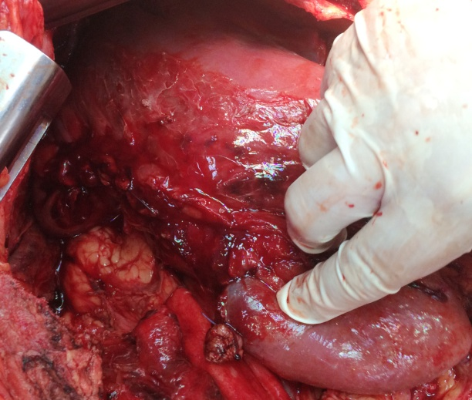
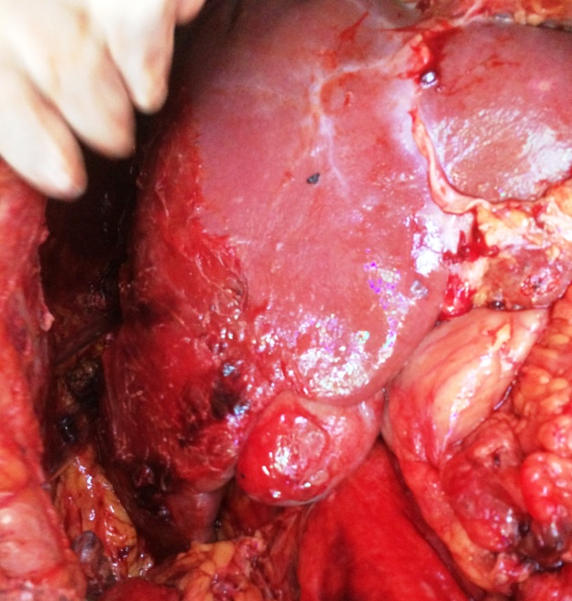

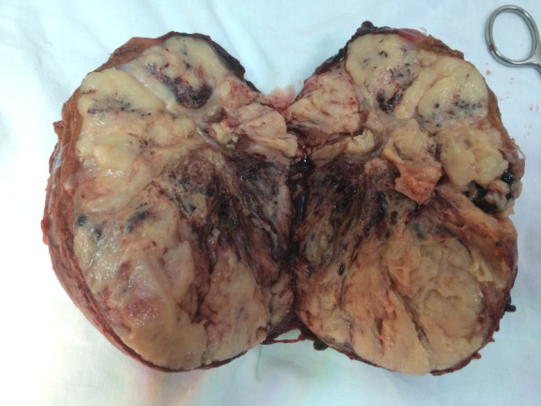
Thank you!

