Slide 1
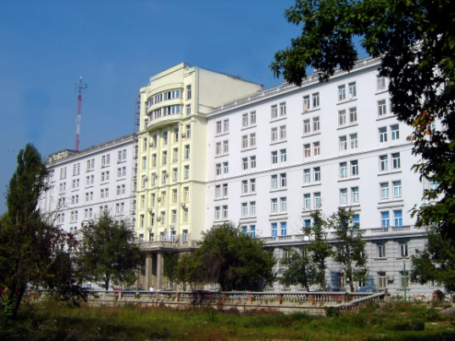
Pancreatoduodenectomy with venous resection for pancreatic cancer
Irinel Popescu, MD, PhD, FACS, FEBS
Professor of Surgery
Dan Setlacec Center of General Surgery and Liver Transplant
Fundeni Clinical Institute - Bucharest, Romania

Slide 2
Pancreatic Head Cancer (PHC)
The main goal of resection in PHC surgery – R0
PHC frequently extends directly into the retroperitoneal spaces (PV/ SMV/ SMA)
A venous invasion is due to tumour location rather than an indicator for an aggressive tumour biology
  Rationale for PV/ SMV resection
Arterial invasion – a sign of tumour aggressive biology ?
Witkowski, J Surg Oncol, 2013; Zhou, World J Surg, 2012; Rehders, Surgery, 2012; Mollberg, Ann Surg, 2011; Buchler, Ann Surg, 2010; Siriwerdana, Br J Surg, 2006; Fuhrman, Ann Surg, 1996

Slide 3
Pancreatic Head Cancer (PHC)
Incidence of a PV/ SMV resection during PD for PHC:
  2 – 77%
Incidence of an arterial resection during PD for PHC:
  < 10%
Witkowski, J Surg Oncol, 2013; Zhou, World J Surg, 2012; Rehders, Surgery, 2012; Mollberg, Ann Surg, 2011; Buchler, Ann Surg, 2010; Siriwerdana, Br J Surg, 2006; Fuhrman, Ann Surg, 1996

Slide 4
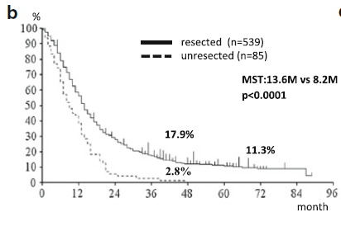
Rationale for Vascular Resections in PHC
Unresected locally-advanced PHC
Vs.
R1 resected PHC
Kato, Hepatobiliary Pancreat Dis Sci, 2013
Konstantinidis, Ann Surg, 2013

Slide 5
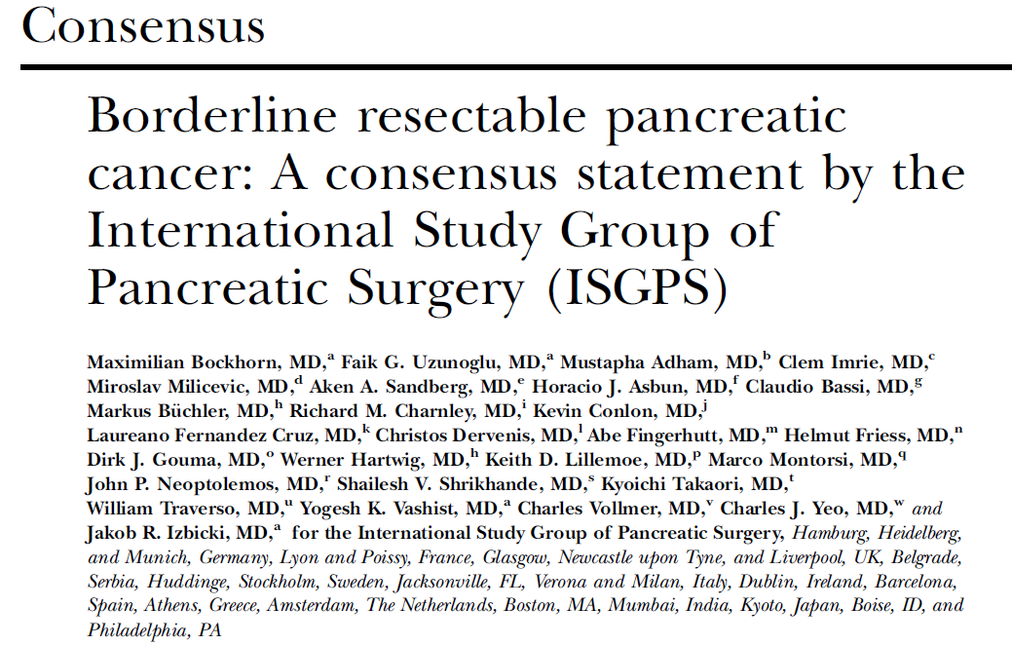

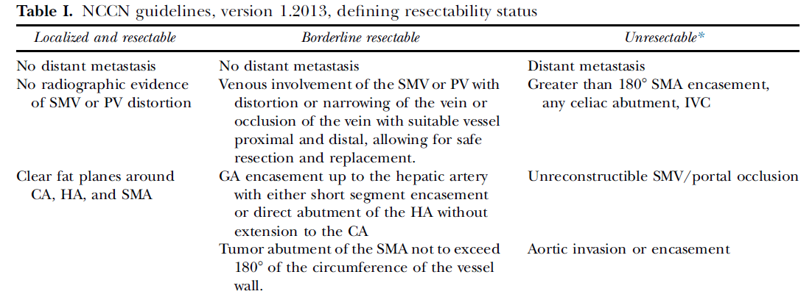

Slide 6
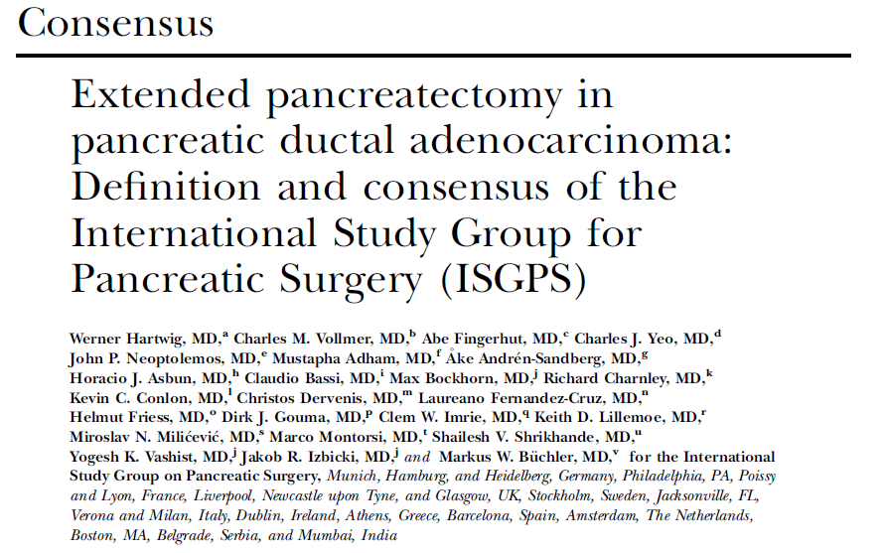
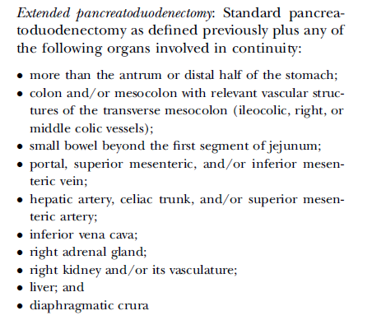

Slide 7
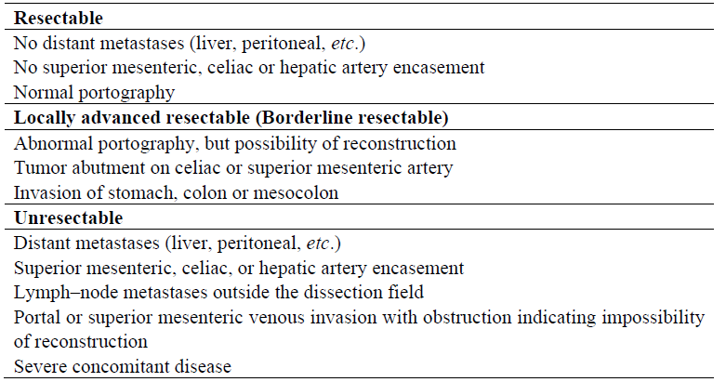
Indications for Vascular Resections in PHC
(invasion < 180° of vascular circumference)
(invasion > 180° of vascular circumference)
(invasion > 180° of vascular circumference)
Nakao, Cancers, 2010

Slide 8
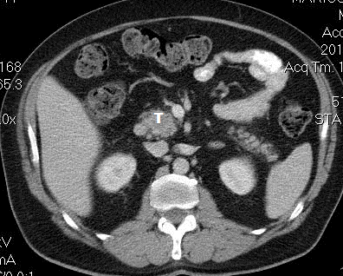
Resectable PHC

Slide 9
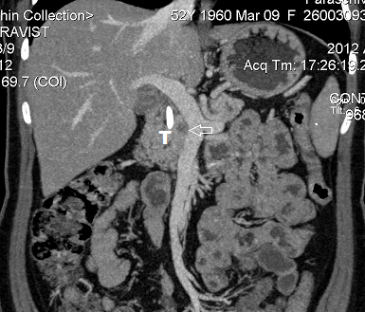
Borderline Resectable PHC
(PV-SMV confluence abutment)
(invasion < 180° of vascular circumference)

Slide 10
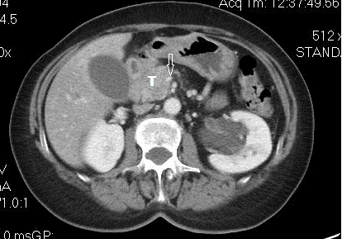
Unresectable PHC
(SMV enhancement)
(invasion > 180° of vascular circumference)

Slide 11
PV/ SMV Resection in PHC
PV/ SMV resection:
  Routinely
  Selectively: most of the surgical teams
T
Fortner, Surgery, 1973; Siriwerdana, Br J Surg, 2006

Slide 12
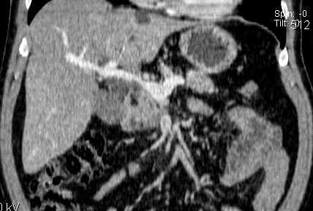
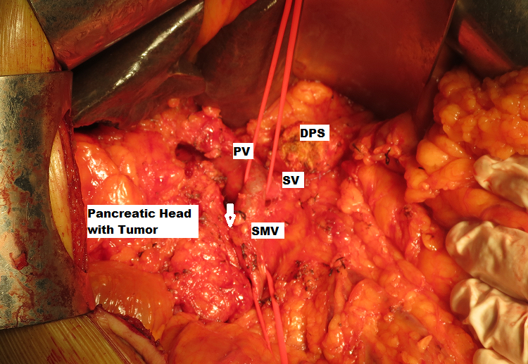
The management of PV/ SMV invasion depends on:
T
  The site of tumour invasion
  Length of venous resection
Lai, Hepatobiliary Pancreat Dis Sci, 2012

Slide 13
Principles of PV/ SMV Resection in PD
Venous resection at a late stage in order to reduce time to venous reconstruction
  Posterior approach facilitates
Graft interposition vs. direct anastomosis
  Direct anastomosis preferred
Routine heparinization – controversial
Lai, Hepatobiliary Pancreat Dis Sci, 2012; Dumitrascu & Popescu, Langenbecks Arch Surg, 2009

Slide 14
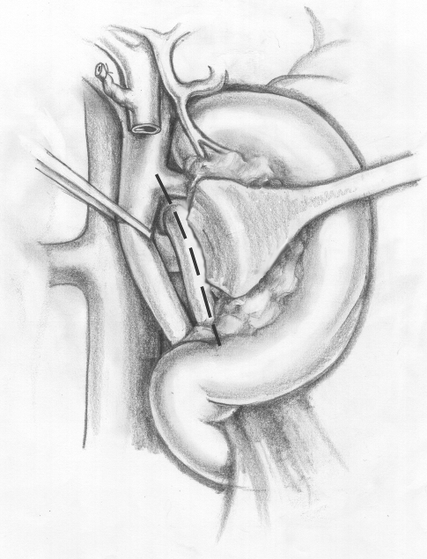
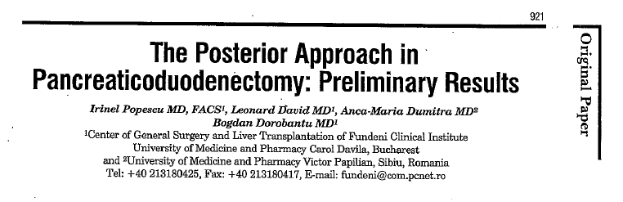

Posterior Approach PD in PHC with PV/ SMV invasion
SMV
T

Slide 15
Posterior Approach PD in PHC with PV/ SMV invasion
isolation of PV/ SMV above and below of the tumour is made without its manipulation during dissection
a reduced time for venous reconstruction
SMV
T
Pessaux, Ann Chir, 2003; Pessaux, J Gastrointest Surg, 2006; Popescu, Hepatogastroenterology, 2007; Dumitrascu & Popescu, Langenbecks Arch Surg, 2009

Slide 16
Posterior Approach PD in PHC with PV/ SMV invasion
Fundeni Clinical Institute Experience
2002 – 2013: posterior approach pancreatico-duodenectomies (paPD group – 29 patients) vs. standard pancreatico-duodenectomies (sPD group – 227 patients).
paPD
sPD
Time of venous occlusion⁴, min | 10 (10 – 20) | 20 (10 – 40) | 0.004¹
SMV
T
Dumitrascu, David & Popescu, HBP Symposium Bucharest, 2015

Slide 17
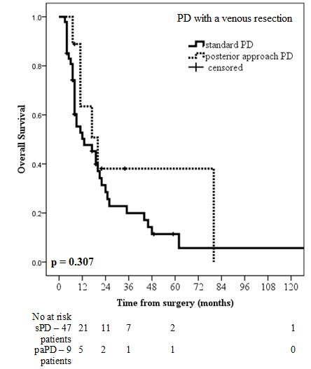
Posterior Approach PD in PHC with PV/ SMV invasion
Fundeni Clinical Institute Experience
In the group of patients with a venous resection it was observed a trend toward better survivals in the paPD group (20 months; 7 – 80 months), compared with the sPD group (13 months; 4 – 141 months), but the statistical significance was not reached (p = 0.307).
SMV
T
Dumitrascu, David & Popescu, HBP Symposium Bucharest, 2015

Slide 18
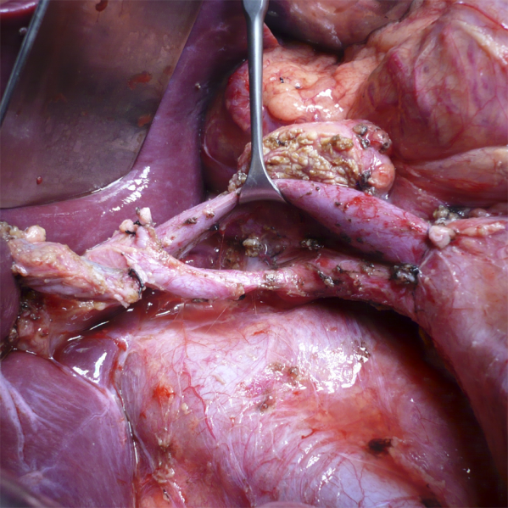
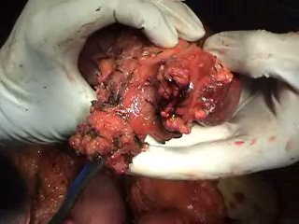
T
SMV
T

Slide 19
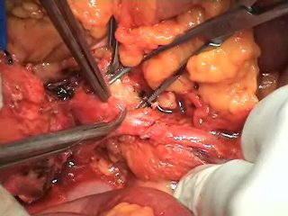
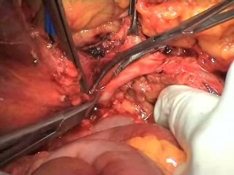
Posterior Approach PD - Technique

Slide 20
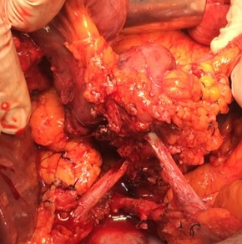
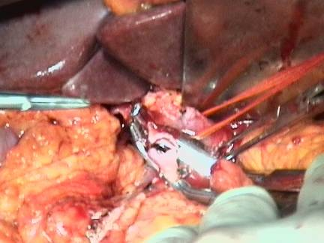
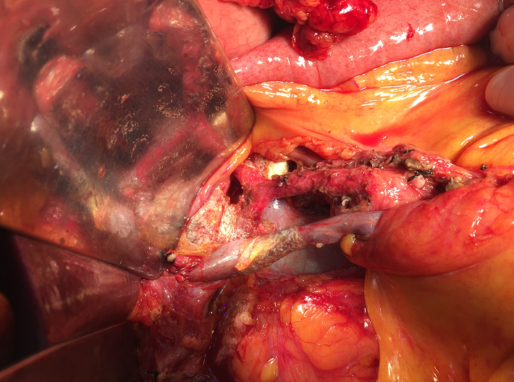
Posterior Approach PD in PHC with SMV invasion
Tumor
SMV
PV
SMA

Slide 21
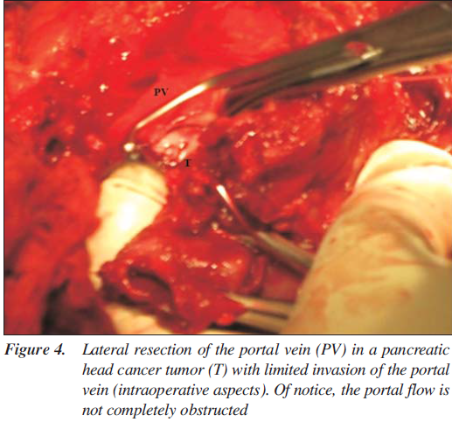
Technical details
Lygidakis, Atlas of Advanced Operative Surgery, Editor: VJ Khatri, 2012
Moldovan, Dumitrascu & Popescu, Chirurgia, 2012

Slide 22
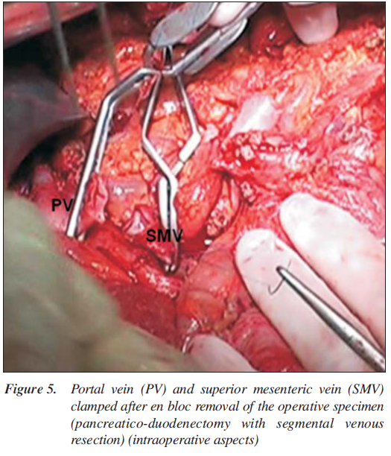
Technical details
Lygidakis, Atlas of Advanced Operative Surgery, Editor: VJ Khatri, 2012
Moldovan, Dumitrascu & Popescu, Chirurgia, 2012

Slide 23
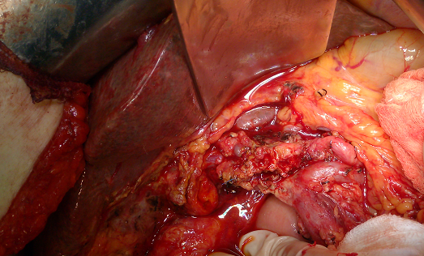
Technical details
Lygidakis, Atlas of Advanced Operative Surgery, Editor: VJ Khatri, 2012
Reconstruction with interposition of venous graft:
Homologous (i.e., splenic vein)
Heterologous
23

Slide 24
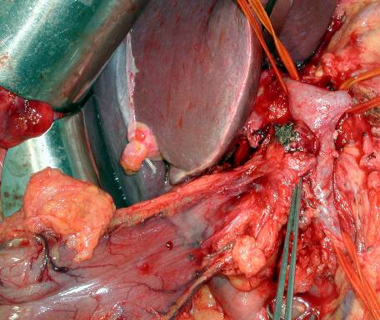
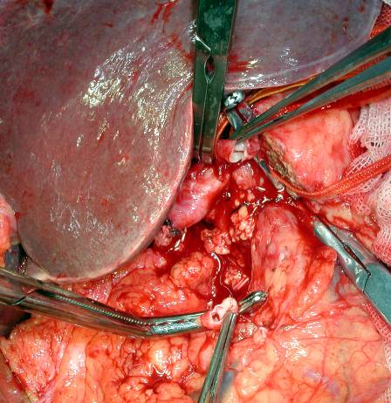
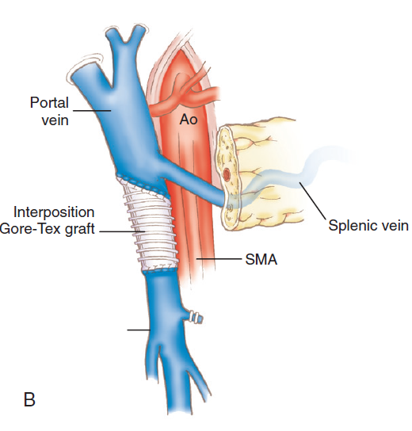
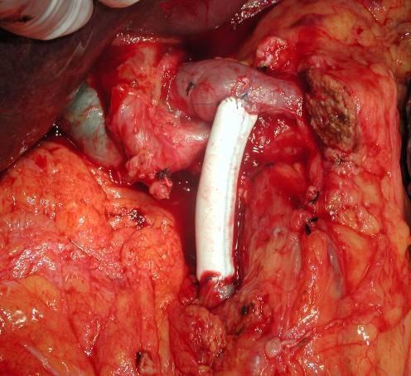
Technical details
Lygidakis, Atlas of Advanced Operative Surgery, Editor: VJ Khatri, 2012

Slide 25
Technical details
Yekebas, Ann Surg, 2008

Slide 26
Outcomes in PD with PV/ SMV Resection for PHC
Morbidity: 42% (6 – 67%) vs. 44%
  Thromboses rate – 17%
    No differences according to anticoagulation
    Higher when synthetic grafts were used
    On late onset – recurrence
30 day mortality: 3.3% vs. 3.7% (0 – 14.3%)
5-year survival: 12.3% (0 – 24%) vs. 17%
    No differences vs. PD without PV/ SMV resection
Zhou, World J Surg, 2012; Tang D, Hepatogastroenterology, 2011; Smoot, J Gastrointest Surg, 2006

Slide 27
Outcomes in PD with PV/ SMV Resection for PHC
Median length of resected vein
  3.9 cm (range, 0 – 10 cm)
Negative resection margins
  16.6% - 100%
Histological proof of venous invasion
  21 – 100%
Zhou, World J Surg, 2012; Tang D, Hepatogastroenterology, 2011; Siriwerdana, Br J Surg, 2006

Slide 28
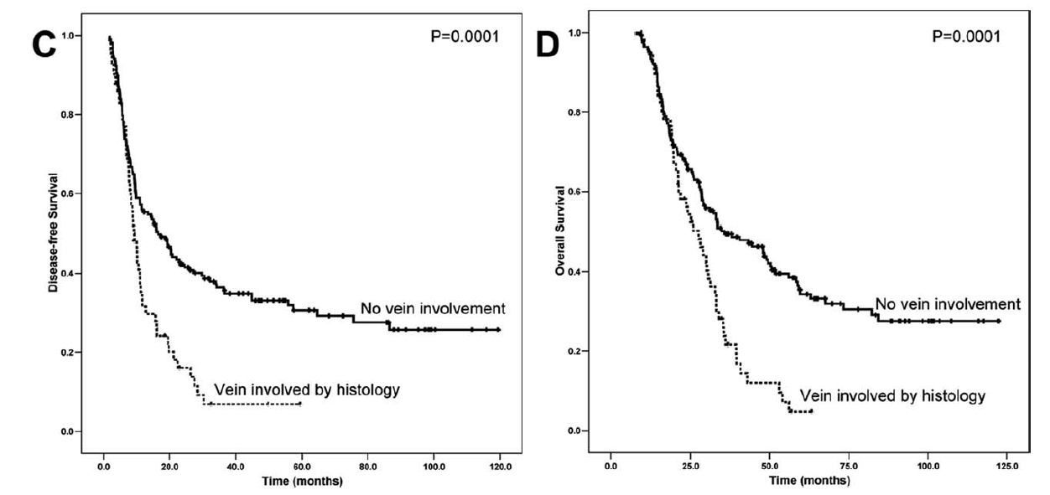
Outcomes in PD with PV/ SMV Resection for PHC
Wang, Cancer, 2012;

Slide 29
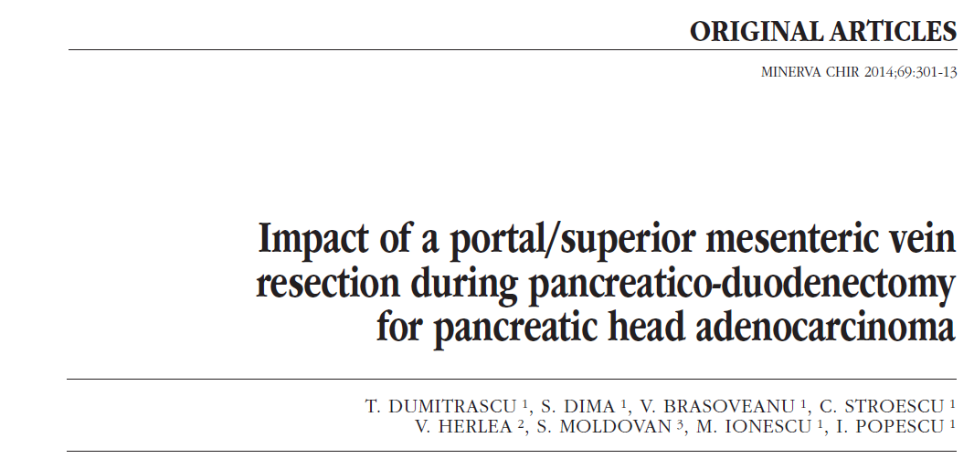
Fundeni Clinical Institute Experience
(PD with PV/ SMV Resection for PHC)

Slide 30
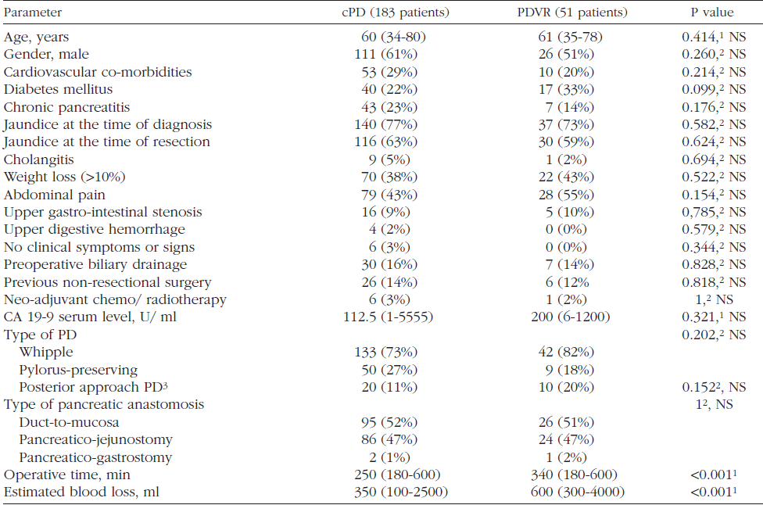
Dumitrascu, Minerva Chir, 2014

Slide 31
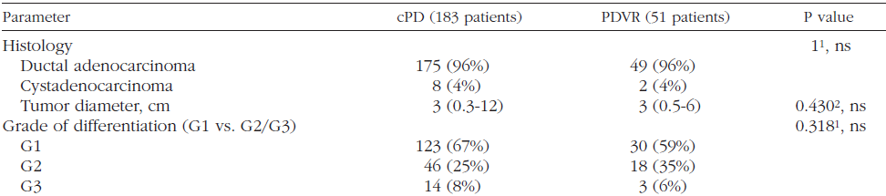
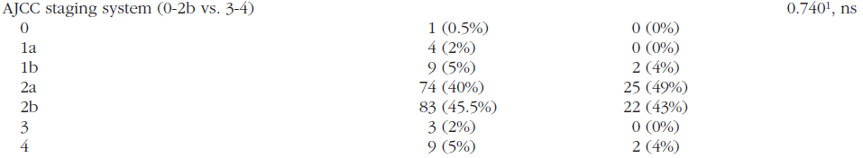

Dumitrascu, Minerva Chir, 2014

Slide 32
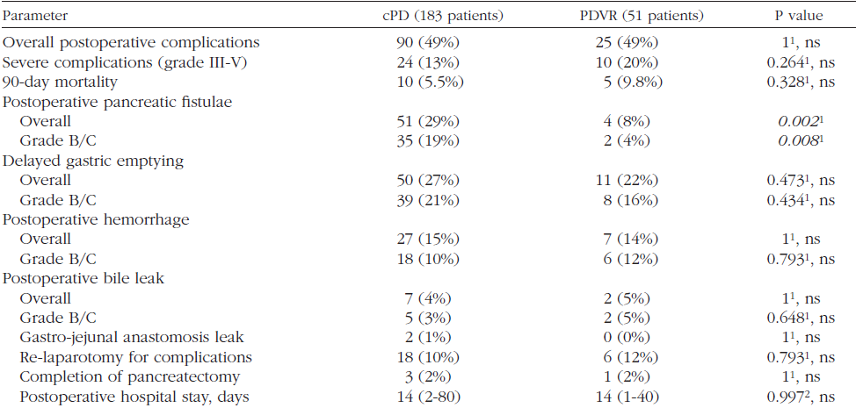
Dumitrascu, Minerva Chir, 2014

Slide 33
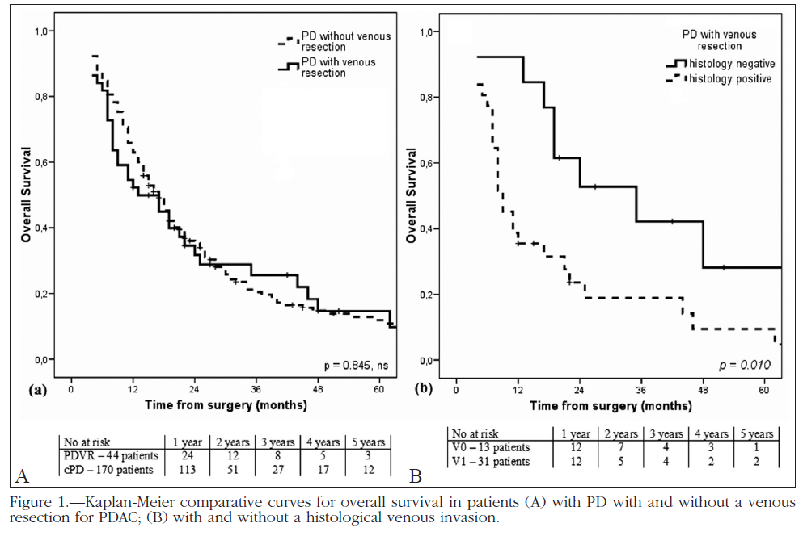
Dumitrascu, Minerva Chir, 2014

Slide 34
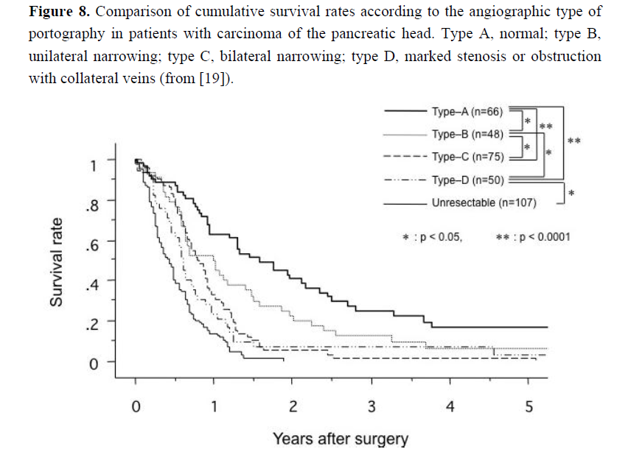
Correlation of the Type of PV/ SMV Invasion with Survival in PHC
Nakao, Cancers, 2010

Slide 35
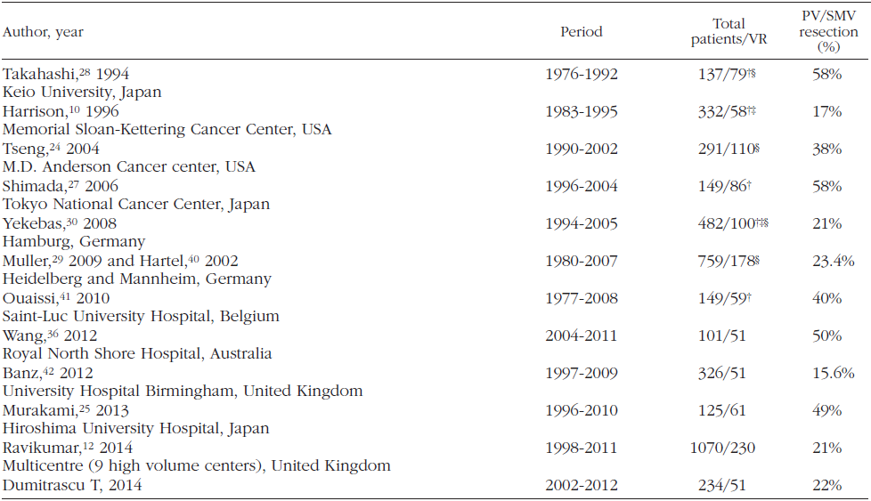
Dumitrascu, Minerva Chir, 2014

Slide 36
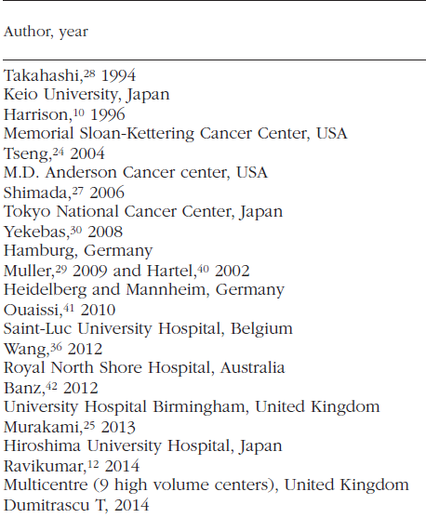
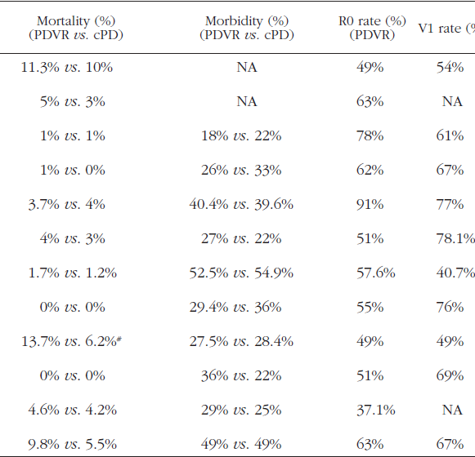
Dumitrascu, Minerva Chir, 2014

Slide 37
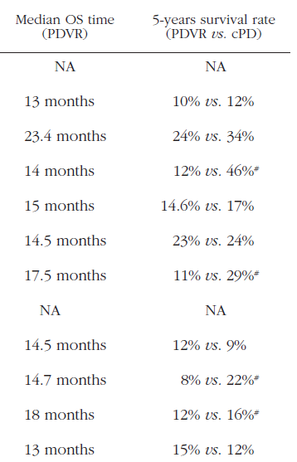
Dumitrascu, Minerva Chir, 2014

Slide 38
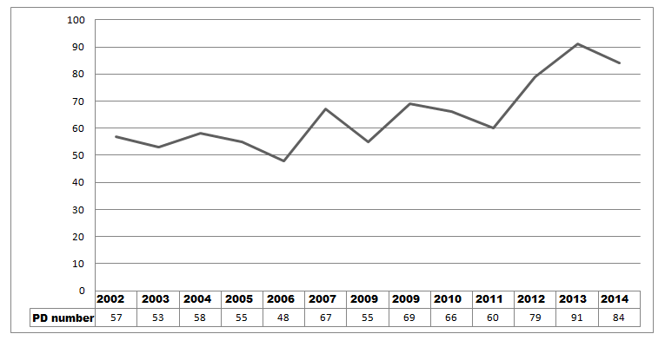
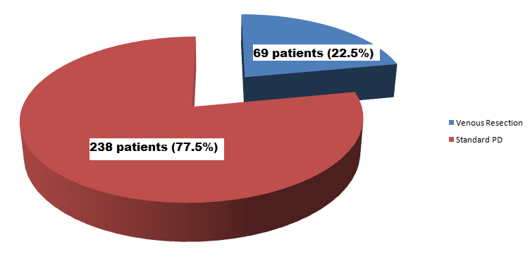
Fundeni Clinical Institute Experience
2002 – 2014
842 Pancreaticoduodenectomies
307 PD for PDAC

Slide 39
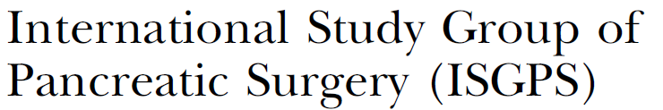


Take Home Messages
PV/ SMV involvement is no longer a contraindication for resection in PDAC
  If reconstruction is possible
  If a compete tumor removal is possible
A trend toward an increased morbidity/ mortality rares should be expected
Recommended to be performed in high-volume centers after a multidisciplinary approach
Routine neoadjuvant treatment is not recommended

Slide 40
Take Home Messages
PV/ SMV resection can be safely performed with acceptable morbidity and mortality
Grafts are rarely needed for venous reconstruction
Posterior approach PD facilitates the venous reconstruction
Survival rates comparable with PD without PV/ SMV resection
T
IVC
Mp
SMV
SMV
SMA
CT
SMA

Slide 41
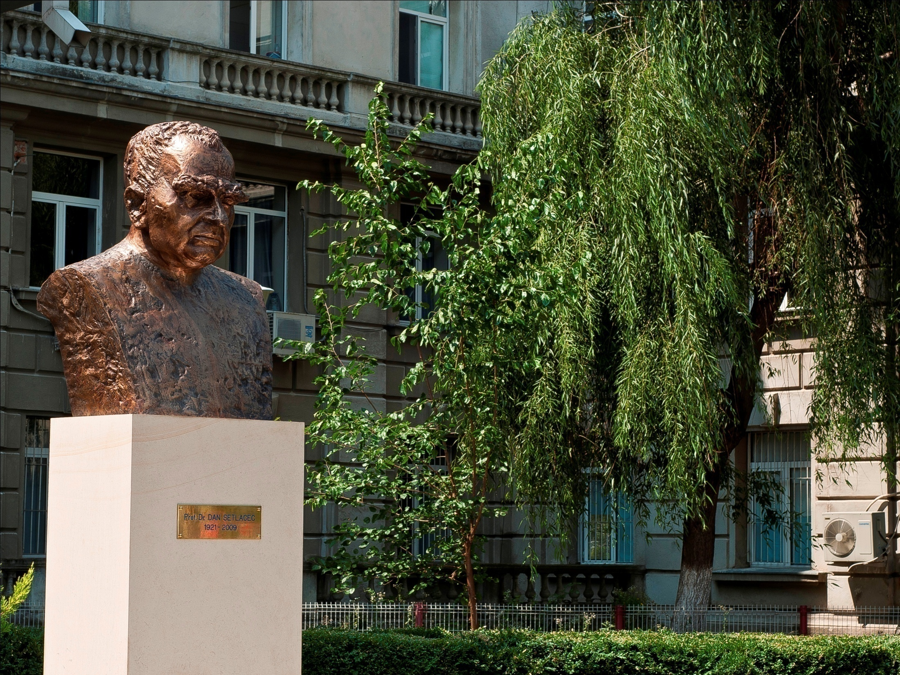
T
IVC
Mp
SMV
SMV
SMA
CT
SMA

